Slide 1
A Level Media Taster Lesson
What is the effect of ownership on media Industries?
L.O.s
Recall prior knowledge
Compare and contrast franchises
Make a judgement on the extent to which cultural industries format their products to maximise audiences and minimise risk
A Level Media basics:
Year 12: | Component 1 & NEA | Media Products, Industries and Audiences | Written examination – 2 hours 15 minutes. 35% of qualification. 90 marks NEA – 60 marks. 30 %
Year 13: | Component 2 | Media Forms and Products in Depth | Written examination: 2 hours 30 minutes 35% of qualification 90 marks
*12 Hours split over 2 weeks *Exam board = Eduqas

Slide 2
PERSON B
DISCUSSION POINT
PERSON A
TURN & TALK: recall prior knowledge and discuss your answers to the following:
What genres of film do you know?
What is the purpose of a marketing campaign?
Why are there so many sequels in the film industry?

Slide 3
*PRE-LEARNING TASK:
https://youtu.be/xD4LDiDAmIM
Mrs Fisher: Media Studies - Hesmondhalgh’s Theory - Simple Guide
*This is usually set prior to your lesson on Google Classroom
Directions: Watch the video and take notes on what Hesmondhalgh’s main ideas are and examples that support this
Idea | Explanation & examples

Slide 4
*PRE-LEARNING TASK:
https://youtu.be/xD4LDiDAmIM
Mrs Fisher: Media Studies - Hesmondhalgh’s Theory - Simple Guide
*This is usually set prior to your lesson on Google Classroom
Directions: Watch the video and take notes on what Hesmondhalgh’s main ideas are and examples that support this
Green pen to perfect your notes!!
Idea | Explanation & examples
Ensure horizontal and vertical integration for success | For example horizontal integration a company buys competing companies - to become bigger or to destroy the competition. Equals more resources. Vertical integration - the conglomerate owns different companies at different stages of production. For example Netflix produces, distributes and exhibits its products.
Companies take advantage of different technologies to work across lots of platforms be successful. | Film companies releasing films in cinemas and on streaming services and having tie in video games.
Formating their products to take advantage of being what is popular and successful | This results in sequels, spin off, use of very successful celebrities or successful genres. Fast and Furious X!! MCU!!

Slide 5
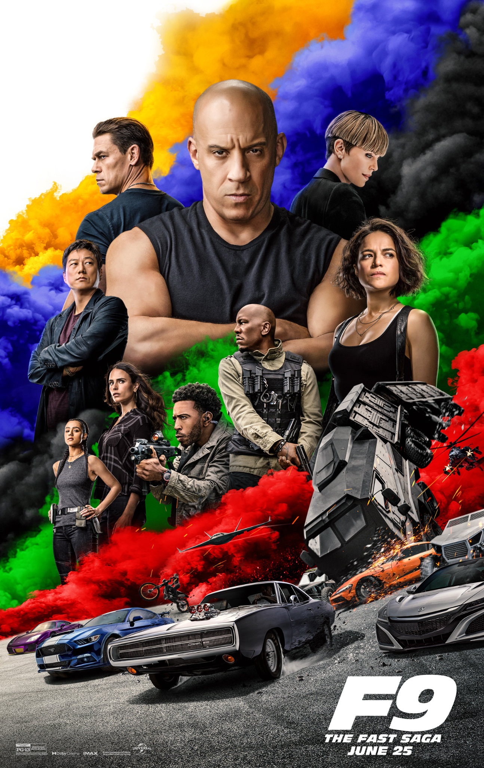
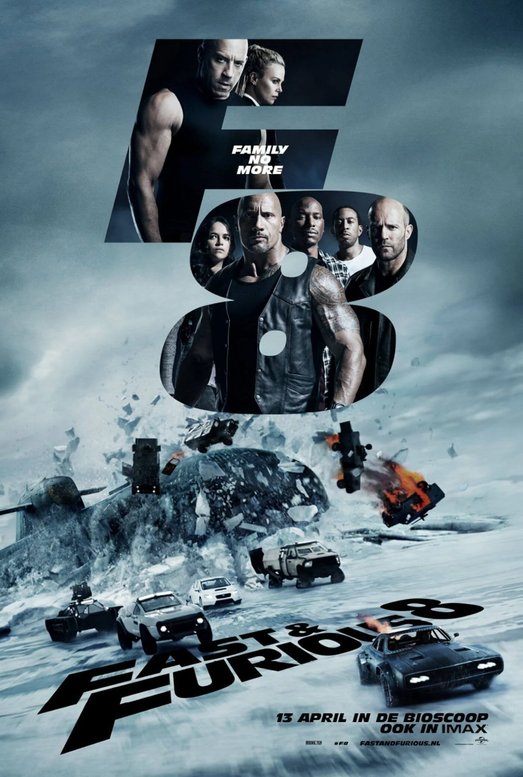
Using these examples, identify how Original Film have minimised risk and maximised their audience in the visual choices made.

Slide 6
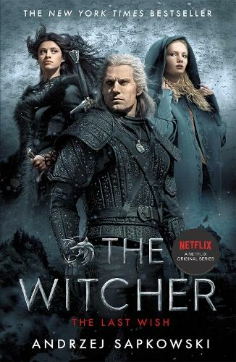
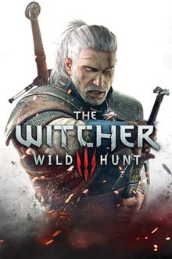
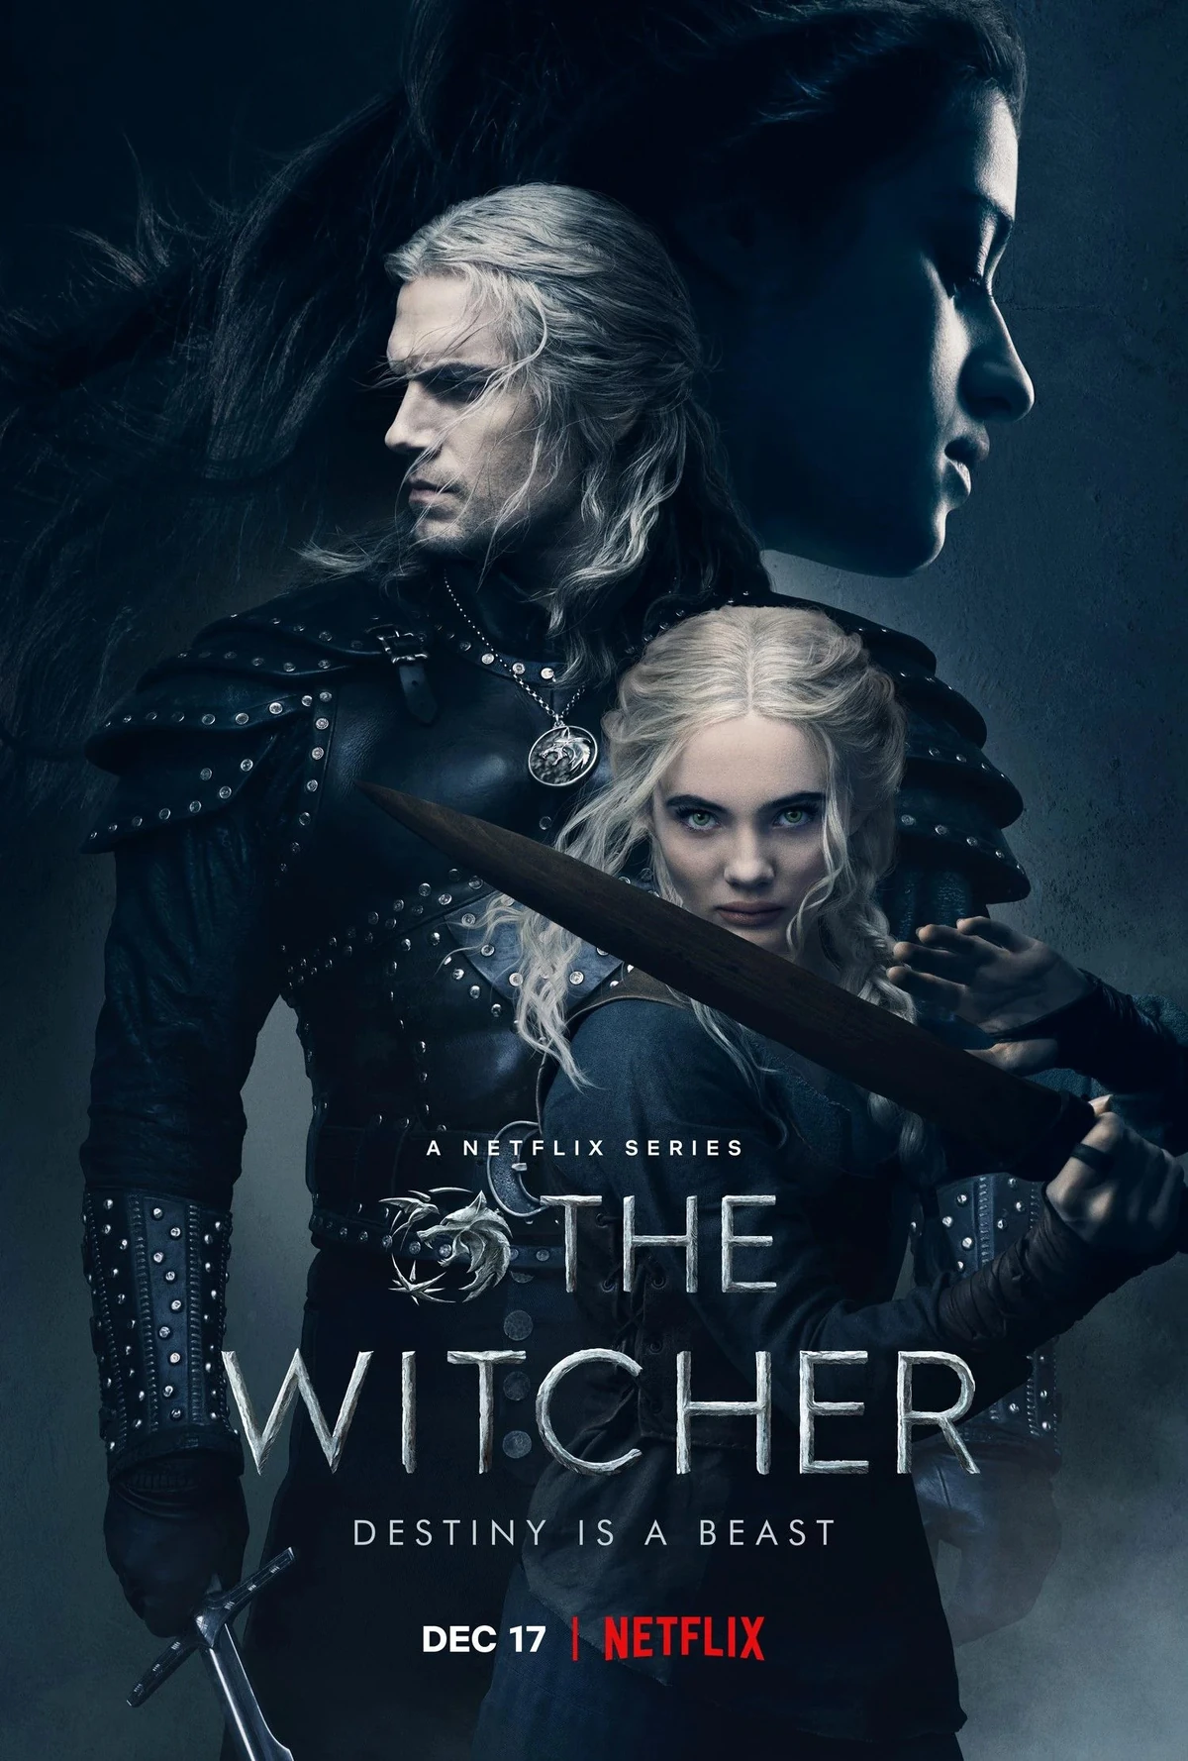
Video game
Book
Series
Using these examples, identify how Hachette and Atari have minimised risk and maximised their audience in the visual choices made.

Slide 7
APPLICATION OF KNOWLEDGE:
Task: Case Studies
Fast & Furious franchise
Group 1
The Witcher franchise
Group 2
Evidence from marketing campaign | How does this fit with Hesmondhalgh’s ideas?

Slide 8
EVALUATION OF THEORY:
Directions: Put an ‘X’ on the scale and be prepared to justify your reasoning. Then after our class discussion write paragraph, using examples you have looked at, to consolidate your position.
How far do you agree that the cultural industries format their products to maximise audiences (profits) and minimise risk?
Completely disagree
Completely agree

Slide 9
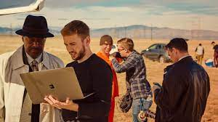
Media - the key to your career…

Slide 10
EXTEND YOUR KNOWLEDGE
The Media Department recommends:
Media Theory for A Level provides a comprehensive introduction to the 19 academic theories required for A Level Media study.
From Roland Barthes to Clay Shirky, from structuralism to civilisationism, this revision book explains the core academic concepts students need to master to succeed in their exams.

