Slide 1
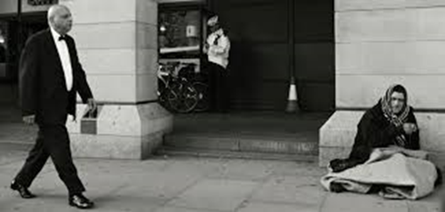
Step Up to Sociology A Level at Stepney All Saints
SOCIOLOGY SUMMER TRANSITION WORK

Slide 2
Week 1 Google Form: https://docs.google.com/forms/d/1Hhk_ukyit2Uy7kC5NZI6RJabAMyg83k4MfHzj2VIFG0/edit

Slide 3
Step Up to Sociology A Level
Exam Board: OCR
Exam papers: You will sit 3 exam papers at the end of year 13. Below is a detailed plan of how you will be assessed.

Slide 4
Topic 1: Norms, Values, Nature Vs Nurture

Slide 5
STARTER: CULTURE
TASK:
What makes up your culture?
Think about what type of food you eat, language you speak, clothes you wear
Do you think you belong to more than one culture?
3 MINS
KEY WORD
Culture – shared way of life of a society or group within a society

Slide 6
CULTURE
The idea of a culture is very important to sociologists
Culture is defined as a shared way of life of a society or a social group within society.
Billington et al. referred to culture as ‘patterns of belief, values, attitudes, expectations, ways of thinking, feeling and so on, which people use to make sense of their social worlds’.
Culture is the entire way in which a society expresses itself.
KEY WORD
Culture – shared way of life of a society or group within a society

Slide 7
NORMS
VALUES
CULTURE is made up of these 4 factors – we will focus on norms
ROLES
STATUS
Norms, values, roles and status and many other elements make up our culture. This is how we are connected to the society around us.

Slide 8
What are norms and values?
Norms refer to the expectations and unwritten rules surrounding how someone should behave in a particular situation. Norms are learned.
They provide shared guidelines of behaviour that teach us what is acceptable within a culture or in wider society.
Norms govern every situation in life, such as the way we eat, dress, how we behave in school, in church and in the supermarket.
Norms govern how we behave in social interactions, the way we interact with people and how we behave in relationships with parents, teachers and employers.
Values are beliefs and ideas that society sees as important and that are accepted by the majority of society. Values refer to what is considered worthwhile and worth working for in society. E.g. privacy, sanctity of human life

Slide 9
Application
and Analysis
NORMS
10 MINS
TASK:
Watch this YouTube Prank: ‘Eating loud in library’
Whilst watching this video, think of 5 or more types of behaviour that acceptable and unacceptable at the library
Acceptable behavior in the library | Unacceptable behavior in the library
https://www.youtube.com/watch?v=fxOjfHFe1xY
KEY WORD
Norms: expectations and shared guidelines of acceptable behavior in particular siutations
Challenge:
Explain what is meant by deviant behavior

Slide 10
WHY ARE NORMS IMPORTANT?
5 MINS
THINK, PAIR, SHARE
What will happen if people did not follow the norms of the library?
How would other people react?
WRITTEN TASK:
Write a short paragraph explaining why norms are so important in society
5 MINS
Sentence Starters:
Norms are important because…
Without norms, society would…
Norms allow people in society…
The importance of norms…
Norms are enforced by positive sanctions, if people follow norms (e.g. rewards) and negative sanctions if people don’t follow them (e.g. being told off). Sanctions are reactions to behaviour that either encourage or discourage behaviour.

Slide 11
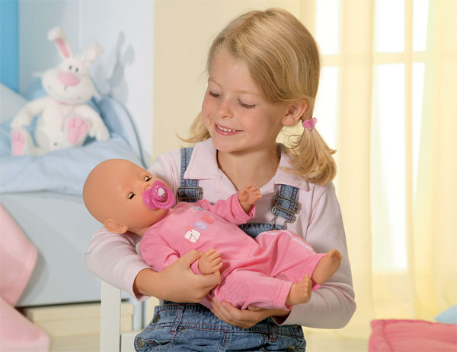
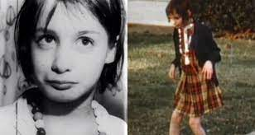
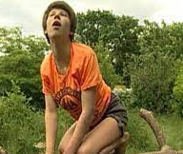
Culture is learned. The norms and values that make up different cultures are taught. The process of learning the norms and values of culture and society is called socialisation. The idea of socialisation can be linked to the nature/nurture debate.

Slide 12
Nature/nurture Debate
According to the nature debate our behaviour, personality traits and abilities are determined by our genetic makeup and what we inherited from our parents
According to the nurture debate most behaviour is learned. We are taught how to behave by our family, friends, media etc

Slide 13
How do we learn the norms of society?
https://www.youtube.com/watch?v=K0Zs-Ic0t9w
1.While you watch the clip consider whether human behaviour is influenced by our biology or by our surroundings? Can you find examples of both? Use the internet to help you

Slide 14
Application and Analysis
‘Behaviour is due to nurture not nature'
FOR:
Sentence starters:
Nurture theory suggests that…
Feral children refer to cases of…
The case study of Oxana demonstrates that..
From this we can see that behaviour is learned through…
P:
E: evidence/examples
E: explanation
R: linking to the statement. How does what you have said support the argument
C: what is the weakness of the theory?
Each side of the nature/nurture debate is aware of the probable influence that both nature and nurture effect human behaviour and traits. For example, children inherit physical traits such as height, but we also know environmental factors, such as diet, will affect height.

Slide 15
Topic 2: Identity

Slide 16
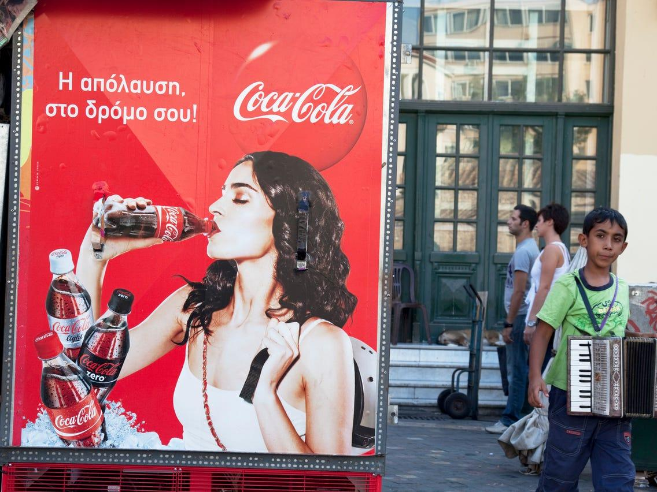
Culture and Identity Analysis task
Research the following terms; consumption, globalisation and cross cultural.
Sociologists recognise that our culture today is based around consumption and materialism. To understand this better consider the following questions:
Questions:
How important are the things that you buy to your life?
How do they shape your identity?
Research the study by Leavis on consumer culture – what did he argue about the key features of this culture?
An important part of consumer culture is the availability of products and goods globally.
Suggest examples of globalisation in action i.e. things that have become cross-cultural. Which technological developments have added to the process of globalisation? How does globalisation strengthen the consumer culture?
Consider the positive and negative effects on individual cultures of such developments.

Slide 17
Socialisation, culture and Identity
Read the following extract taken from an article by Halsey
Life in Britain can no longer be said to be uniquely British, a leading social scientist declares.
Growing international homogeneity and the dominance of American culture mean that it is increasingly difficult to pinpoint Britishness, according to the sociologist A.H.Halsey. He suggests that Britain has lost the distinctiveness it had when he was a child, and that our lives are becoming Americanised to the point that life in Britain can no longer be said to be uniquely British. (Adapted from Brindle 2000)
Cultural sameness

Slide 18
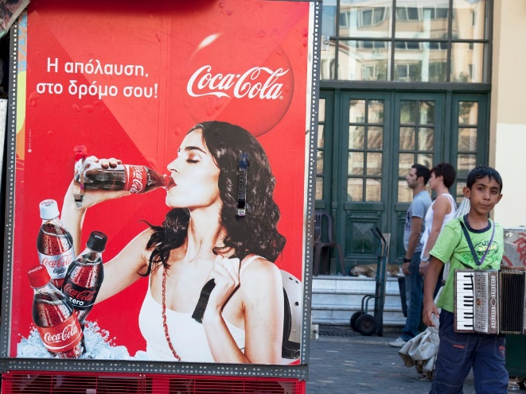
Socialisation, culture and Identity
Why does Halsey claim Britain is experiencing cultural homogeneity?
Do you agree that our lives have become Americanised?
Bigger picture: Consider why some may feel that this process has threatened cultural diversity.
3. Can you provide examples in modern society that supports the idea that our lives have become Americanised? How much of American culture is embedded in your own life? Explain your answer

Slide 19
Topic 3: Family

Slide 20
Family: Research task:
Define the family type.
Has the family type increased or decreased in contemporary society? Identify key trends (use the internet to find statistical data)
Identify reasons for the increase or decrease.
Create a fact sheet on each type of family.
Nuclear family
Extended family
Lone parent family
Reconstituted family
Same sex family
Non family households
Living alone
Living apart together
Watch the clip
https://www.youtube.com/watch?v=VRwKlvcWE3E
What are the findings from the clip.
Explain how the findings challenge traditional gender roles within the family.

Slide 21
Family: Research task:
Watch the following clips; The British Family https://www.youtube.com/watch?v=fI40wizRNc4 (Part 1)
https://www.youtube.com/watch?v=X0nOz1WFyJE (Part 2)
https://www.youtube.com/watch?v=atykiYfMzjI (Part 3)
https://www.youtube.com/watch?v=nQt8Z_Y-6OI (Part 4)
Explain how the role of children, parents and the elderly have changed in the family.
Discuss the following question in light of evidence found: Is the family a happy place for everyone? Refer to the video clips to support your points.

Slide 22
Week 2 Google form: https://docs.google.com/forms/d/16lDNGY6A5crmludfYuf8EOncjUiZtfoZefR_ZcQkCAc/edit

Slide 23
Topic 1 Social Inequality

Slide 24
Social Inequality and Gender
Use the internet to find evidence of how men and women may experience disadvantage in each area of life
You can include sociologists, trends, real life stories and articles.
You can type your evidence on a word document.
What is the relationship between gender and
inequality?

Slide 25
Research Task: What measures have been taken to tackle inequality?
Have these measures worked? If so how effective have they been? If not, why not?
Which gender has poorer life chances and why?

Slide 26
Social Inequality and Class
Challenge task: Using the internet find out Marxist view on social class.
Explain how Marxist will view social inequalities.
What is the relationship between class and
inequality?
Poor Kids: Life on the breadline
Watch the clip below;
https://www.youtube.com/watch?v=i9aSp9bFmMg
Using this clip, analyse how an individual’s social class may be a factor in creating inequalities? Discuss in detail and use examples from the clip to support your answer.

Slide 27
Topic 2 Education

Slide 28
Education
What is the relationship between ethnicity and educational achievement?
What do the statistics show in regard to exam success and ethnicity?

Slide 29
Education
What explanations have been put forward to explain differential educational attainment between different ethnic groups?
Watch the following clip on YouTube called; Teacher TV: Black Boys
Brainstorm all the reasons why black boys are underperforming?
https://www.youtube.com/watch?v=n0UI-sqA_z0
Using the internet find the key trends on educational achievement for ethnic minorities and gender (must be recent data).
Explain your findings.
Evaluate the explanations you have found. What are the strengths and weaknesses of the explanations provided on differences in attainment levels between different students?
Explanations

Slide 30
Week 3 Google Form: https://docs.google.com/forms/d/1PLKJHSMuyd8Qb_gkPYOoUHO3oxTWnWH-yVQqOB9OXL8/edit

Slide 31
A Level- Research Methods
Research methods are all about what sociologists do. Many sociological theories are underpinned by evidence. Evidence has to be collected from the social world around us and this requires empirical research to be done. ‘Empirical’ simply means ‘based on evidence from the real world’. The process of carrying out research and collecting evidence distinguishes sociologists from those who make claims about society based on common-sense opinions, personal experiences or prejudices

Slide 32
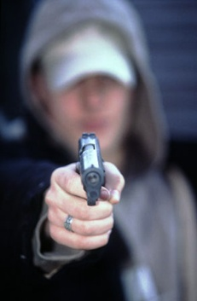
Activity – Researching violent crime
Ask 2 people you know, whether violent crime has increased in the last ten years. Next, ask them where they have got their ‘evidence’ from.
Is their evidence based on research findings, or personal opinion?
Official crime statistics states that the overall level of gun crime in England and Wales is very low – less than 0.5% of all crime recorded by the police and the number of overall offences involving firearms fell by 2% in 2007-08 compared to the previous year. Does this finding differ from the perception of your friends/family? Why do you think this might be?
Investigate where official crime statistics, such as the ones above, come from. Can you see any problems with this as evidence? What is missing from this data?
Watch the following clip; https://www.youtube.com/watch?v=jzdTiM5wS_c -
Answer the following questions:
What is the dark figure of crime?
How reliable are official crime statistics?

Slide 33
Tasks:
Types of data – primary and secondary
Primary data is information collected by sociologists themselves for their own purpose. These purposes may be to obtain a first-hand ‘picture’ of a group or society, or to test a hypothesis (an untested theory).
Task 🖉
Write down 3 methods which could be used to gather primary data

Slide 34
Secondary data is information that has been collected or created by someone else for their own purposes, but which the sociologist can then use.
Task 🖉
Write down 2 methods which could be used to gather secondary data

Slide 35
Evaluation Task 🖉
Complete the following table. Some of the advantages and disadvantages have been completed for you. Use the internet to help you complete the task.
 | Primary data | Secondary data
Advantages | The data is very contemporary and up to date | It’s a quick and cheap way of doing research.
Disadvantages |  | It may not provide the exact data

Slide 36
Factors influencing choice of method: PET
Given the wide range of methods available, sociologists need to select the right one for their research. Different methods and sources of data have different strengths and limitations in terms of practical, ethical (moral) and theoretical issues.
Task 🖉 Use the Internet, complete the boxes on the following slide, summarising the different practical, ethical and theoretical issues which influence a choice of research method

Slide 37
Evaluation Concepts: Practical issues
Time and money | Funding bodies
Personal skills & characteristics | Subject matter
Research opportunity | Access & safety of the researcher
Ethical issues
Informed consent | Confidentiality & privacy
Effects on research participants | Vulnerable groups
Covert research & deception | Which do you think is the most important factor? Why?

Slide 38
Research in action:
https://www.youtube.com/watch?v=yAkDHuimJRc
https://www.youtube.com/watch?v=Lp5twji3pk8
Watch the following clips
Answer the following questions:
What methods were used?
Identify the ethical issues that were broken in this piece of research.
Identify and explain what the researcher did to overcome breaking the ethical issues.
Do you think researchers should be allowed to break ethical guidelines for the purpose of research? Watch this panorama documentary on abuse in care home.
Analyse whether the strengths of the study outweighed the weaknesses of breaking the rules.

Slide 39
Factors influencing choice of topic
Read the following article
This is affected by many things, most of which are to do with the interests and the values of the researcher, which are usually interrelated. Peter Townsend has had a life-long commitment to the needs of the poor and the powerless, and his studies of the elderly (1957) and the poor (1979) are the result of that commitment. Researchers will also be influenced by current debates in the academic world. Thus Goldthorpe and Lockwood (1969) carried out their research among the manual workers of Luton at a time when academic opinion was saying that such people were beginning to take on middle-class characteristics. The commitment of sociologists such as Mirza (1992) and Sewell (1997) to studying the educational experience of young African-Caribbean girls and boys has been derived to some extent from their own background as African-Caribbeans. Choice of topic will also be affected by the funding of the research. Researchers who depend of grants from organisations like the Economic and Social Research Council (ESRC), or from private foundations like Joseph Rowntree, will only be able to carry out their enquiry if it is approved by the organisation in questions. Academic researchers working in higher education have to convince the relevant committees in their institution that the work is important enough for scarce resources to be devoted to it. Sometimes research is commissioned, and the researcher is approached by government, a local authority, a business, or a charity to carry out a specific enquiry on their behalf.

Slide 40
This will almost invariably be linked to the policy objectives of the sponsoring organisation. Broadly speaking, it is easier to obtain funding for explanatory research that seems to provide guidance to policy-makers than for purely academic research, and for research that is statistically based than for research that is more qualitative in its approach. The choice of research topic is not made in a vacuum, but is influenced both by the researcher and by the context in which the research is to be done. This does not automatically mean that the research is biased. Just because researchers have strong feelings about what they are investigating, it does not automatically follow that their findings will be slanted in favour of their own beliefs and values. Indeed, this is a major difference between sociology and journalism. It is also worth remembering that the choice of topic is affected by the power of the subjects of the research to resist the investigation. How far such resistance is possible varies according to the research methods employed but, generally speaking, we know more about the poor and the powerless than we do about the rich and powerful.
Source: McNeill, P & Chapman, S (2005) Research methods

Slide 41
Task 🖉 Using the extract above, explain the different factors which influence the choice of topic for a researcher. You should have at least 4 sub-headings.
You may wish to present it in picture / diagram form.

Slide 42
Social surveys and research design
Read the following article;
A social survey is a method of obtaining large amounts of data, usually in a statistical form, from a large number of people by asking them questions about their lives, attitudes, opinions or behaviour. It usually takes the form of a self-completion questionnaire or a structured interview. Whichever survey method is used, the social survey has for many years been the most widely used method of social research. Examples of large-scale surveys include the British Crime Survey and the General Household Survey. The Census, which is carried out by the government every ten years is the most large scale social survey. Positivists advocate the use of the survey method. It is regarded as scientific because surveys are normally carried out under controlled conditions. They are organised in a logical and systematic fashion via questionnaire design. If the research is properly carried out, the personal influence of the researcher on the results is slight. In other words, they are seen to be objective and value-fee. Very importantly, they are easily replicated and the quantifiable data can be verified by others. Moreover, the survey produces large amounts of statistical information relatively quickly and cheaply, which enables comparisons to be made between different groups and populations. Surveys are also appealing because they can be aimed at large groups of people.
On the other hand, Interpretivists argue that social surveys with their emphasis on scientific logic and statistical data give us little insight into how people see and understand their lives. Surveys are seen as artificial devices that produce artificial responses – approaching respondents like this crates a thoroughly unnatural situation, so whatever the results, they won’t have much bearing on what respondents usually think, generally feel, normally experience, or really believe.
Source: McNeill, P & Chapman, S (2005) Research methods

Slide 43
Evaluation Task 🖉
Read the extract above and answer the following questions:
Explain how positivists see the survey method as:
reliable
valid
representative
2. Explain why Interpretivists see the survey method as lacking in validity.
Challenge task: Use the internet and the source material to outline the following approaches;
Positivists approach to research.
Interpretivists approach to research.
Explain what approach will collect more valid data.

Slide 44
Questionnaires
Questionnaires are lists of questions compiled by the researcher and completed by the respondent. There are different types of questionnaires / question design.
Task 🖉
Define the following:
Closed questions -
Open-ended questions -
Measurement scales –
Provide two examples of a closed question and an open question.
Explain what questions will provide more valid data.
What approach will support open questions and why? Explain your answer.
What approach will support closed questions and why? Explain your answer.

Slide 45
Evaluating questionnaires
Using your own independent research, complete the table below.
Advantatages of questionnaires | Disadvantages of questionnaires

Slide 46
Interviews
Like questionnaires, interviews involve asking questions. The main difference is that questionnaires are completed by the respondent (self-completion), whereas interviews involve a social interaction between the interviewer and respondent.
Evaluation Task 🖉
Can you think of two advantages of carrying of face-to-face interviews, as opposed to a self-completion questionnaire. Write them down in the space below:
1
2
Using the internet find the different types of interviews used by researcher
Define
Explain the advantages and disadvantages.

Slide 47
Watch this interview and consider the following points:
What type of interview is taking place?
Why was this type of interview used?
What type of data did this interview produce? Data in number (quantitative) or data in words (qualitative).
What are the strengths and weaknesses of the data produced?
https://www.youtube.com/watch?v=rqQEWlZWhP0

