Slide 1
SIXTH FORM CODE OF CONDUCT
All students in the Sixth Form have chosen to continue in full time education beyond the age of 16 and as such are expected to behave as young adults, showing consideration for others and displaying a high level of commitment in everything that is undertaken.
As a member of the Sixth Form community, you will be expected to uphold the Sixth form rules: in the event of transgression you will be subject to the disciplinary procedures agreed by the Governing Body which is outlined in this document.
All Sixth Form students are expected to take part in a range of enrichment opportunities that support them in developing their non-academic learning and skills in preparation for university or higher level work related learning. This includes, but is not limited to, the Personal Development Programme, the SASS Champions Programme and the SASS Futures Programme as well as the Career Ready Programme. This supports their development of leadership, teamwork, communication and interpersonal skills.

Slide 2
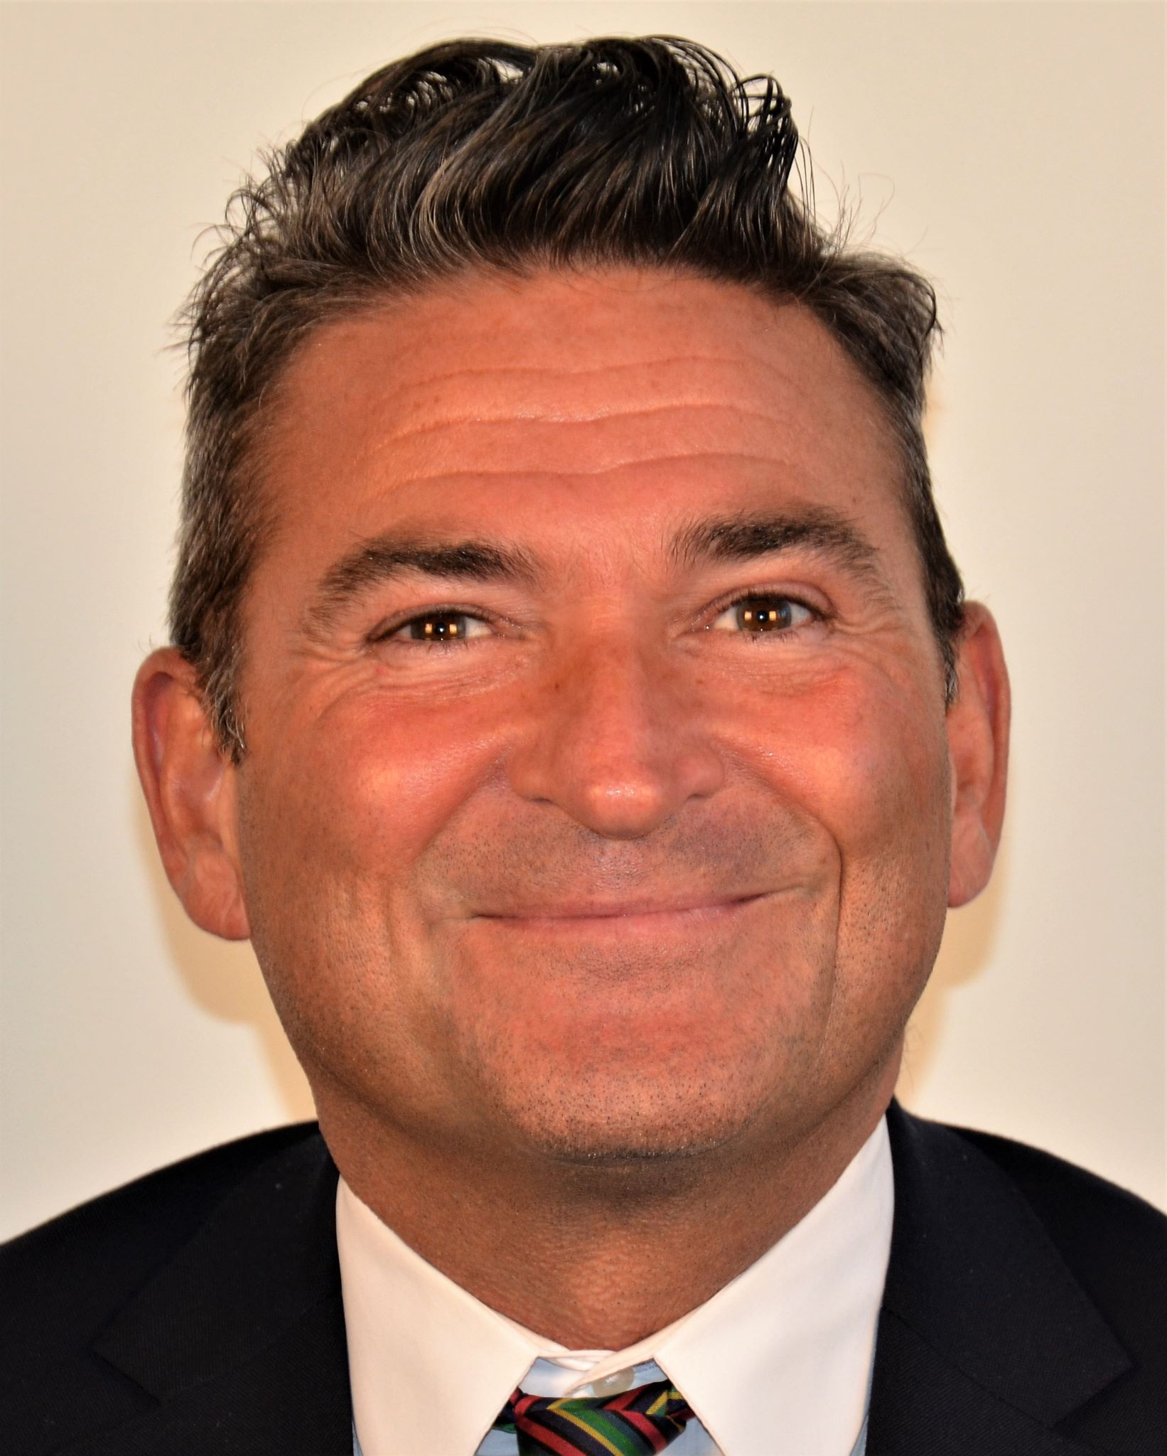
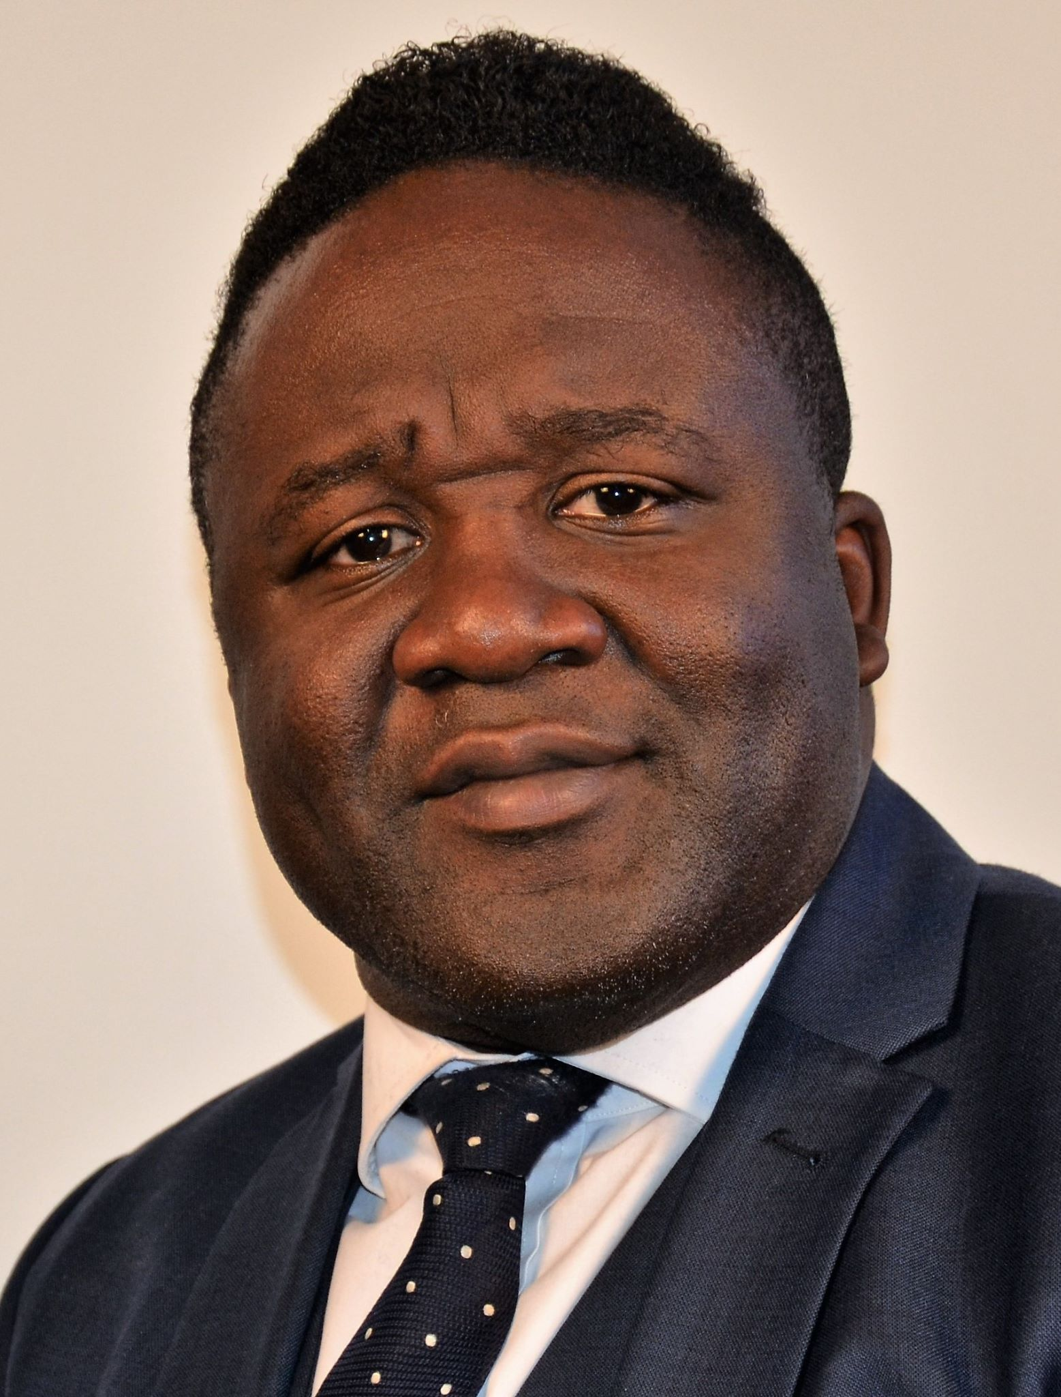
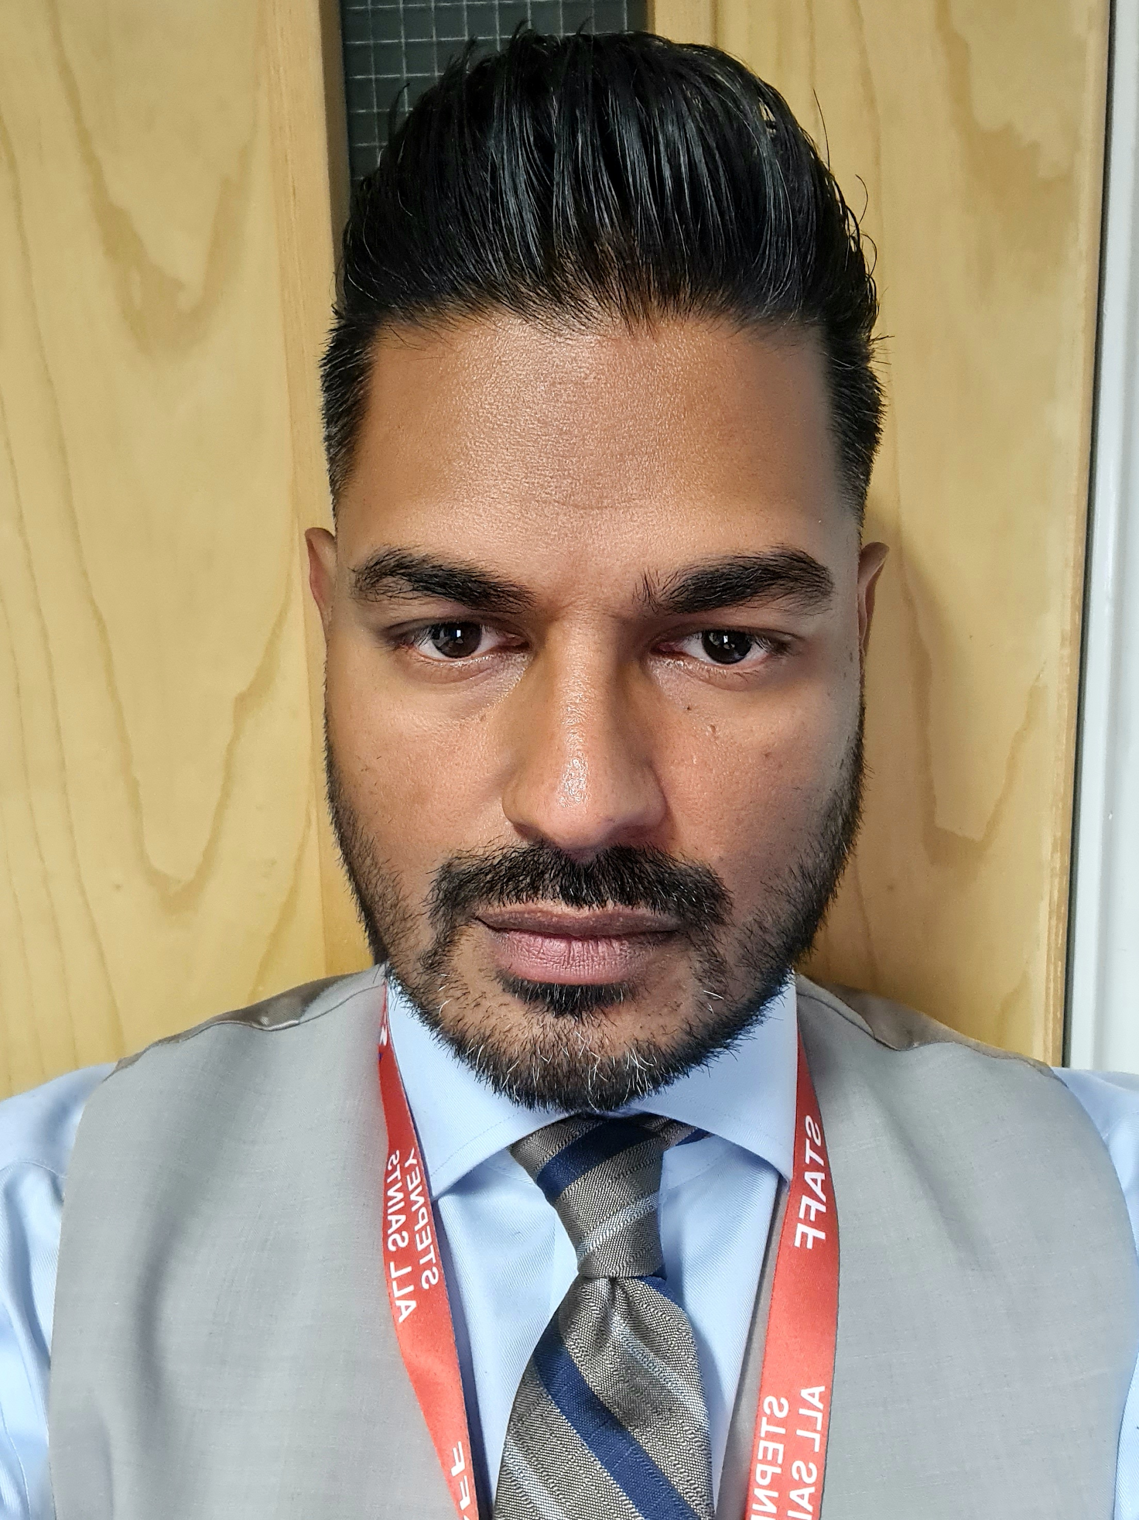
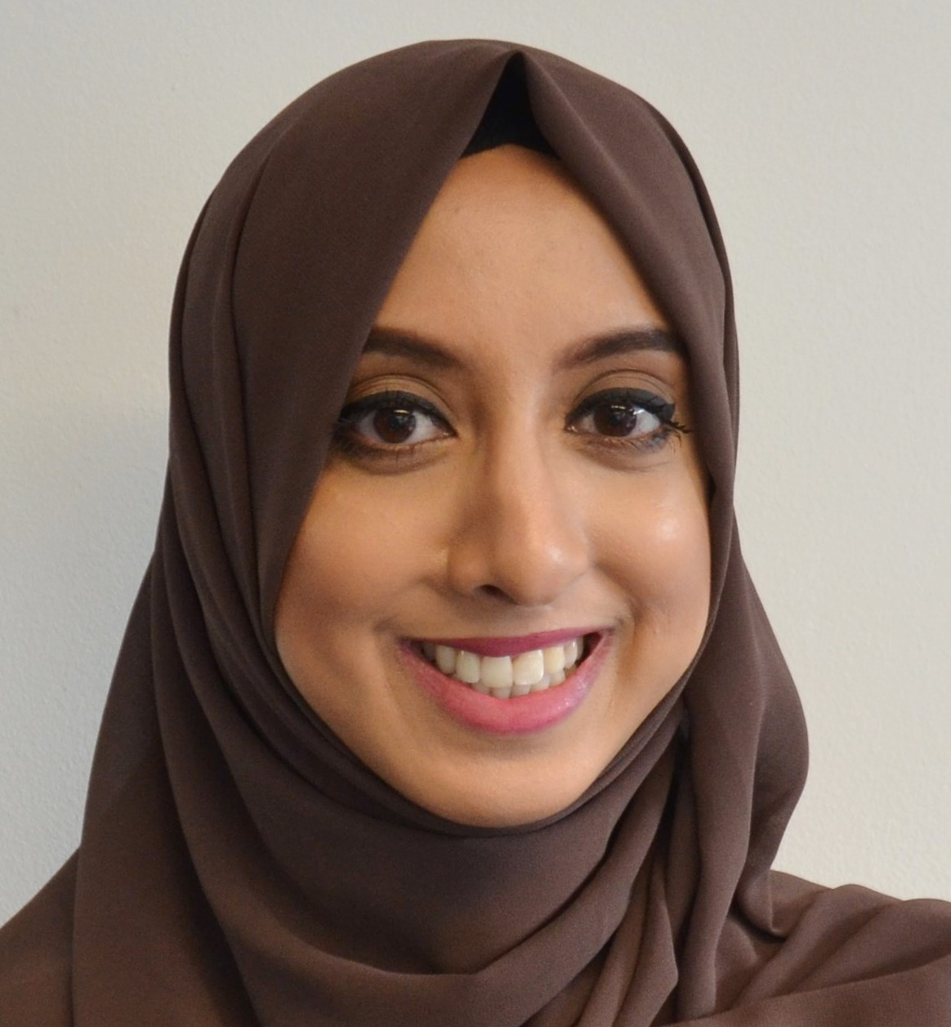
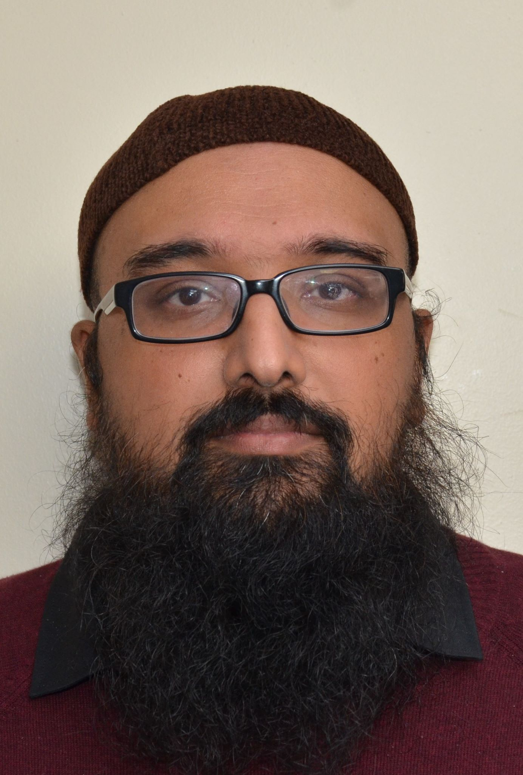
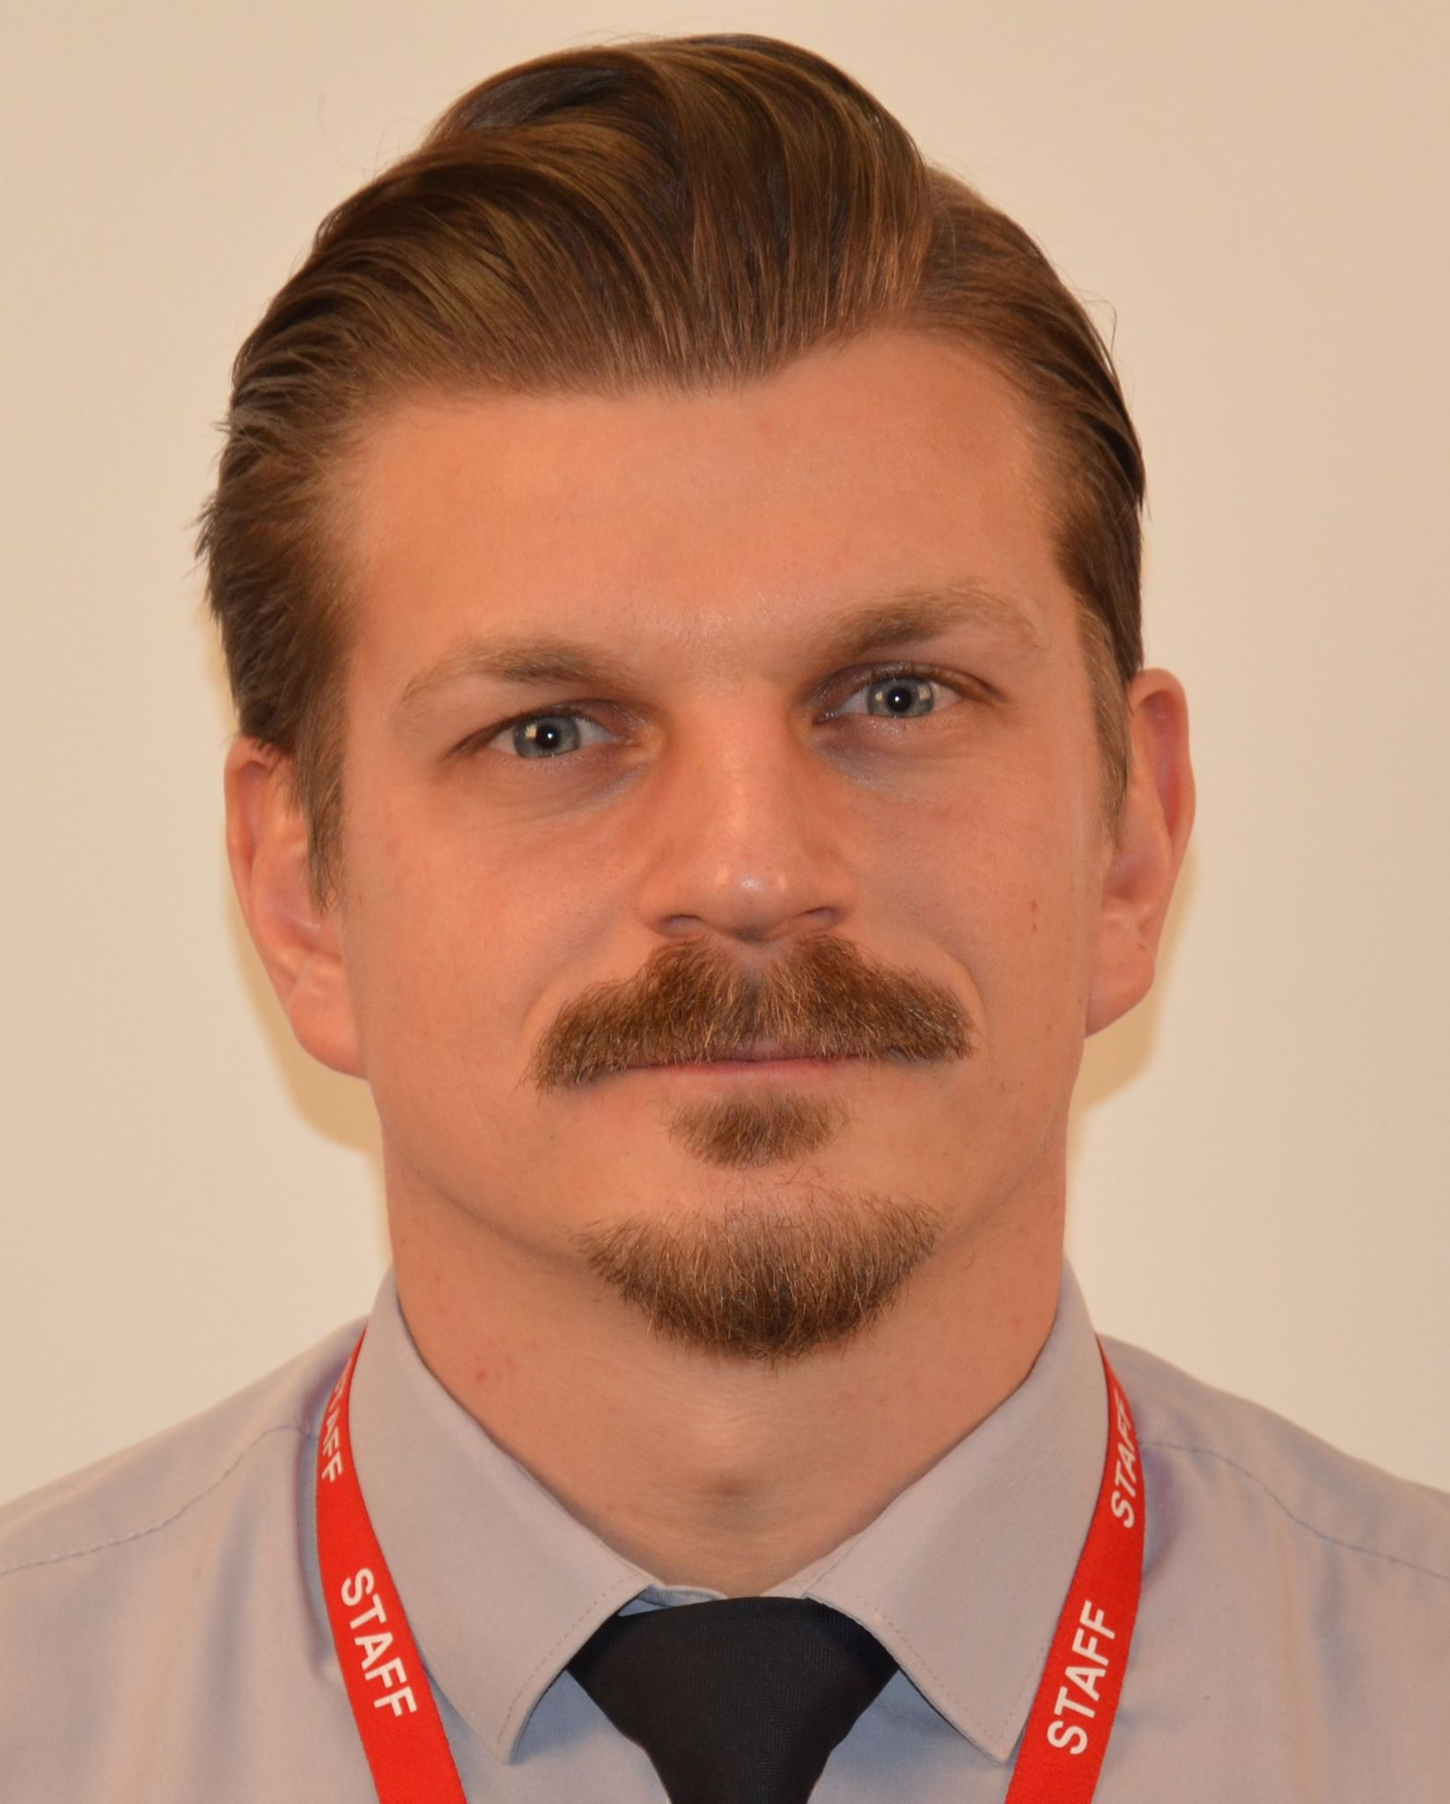
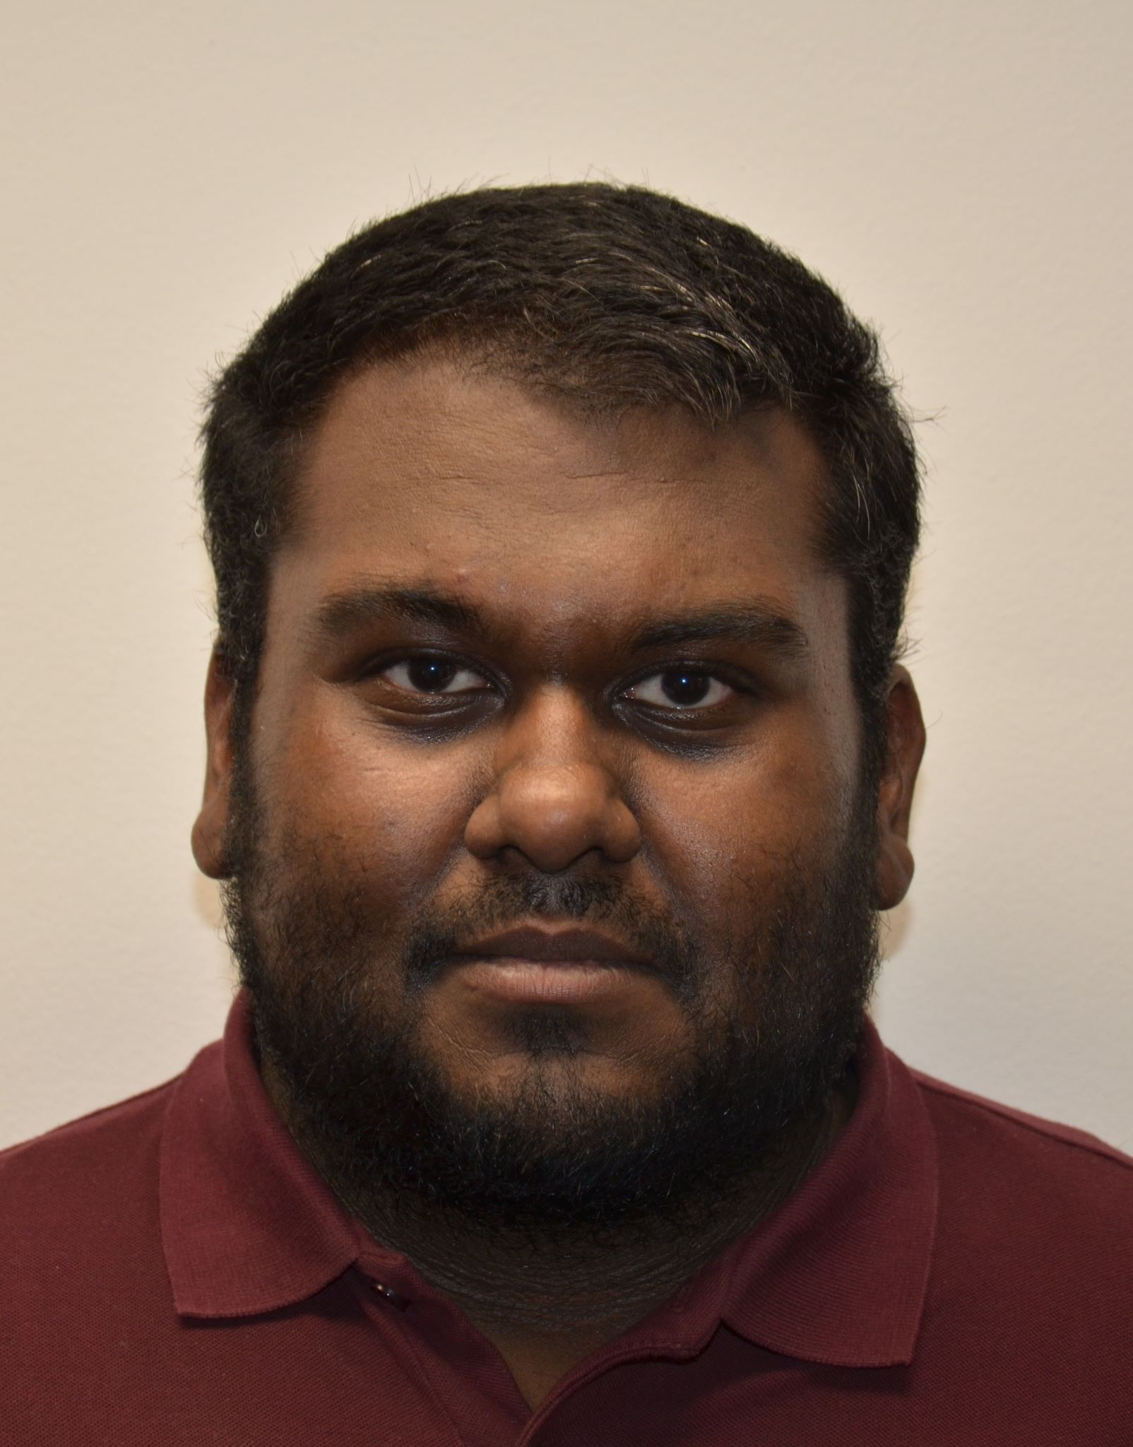
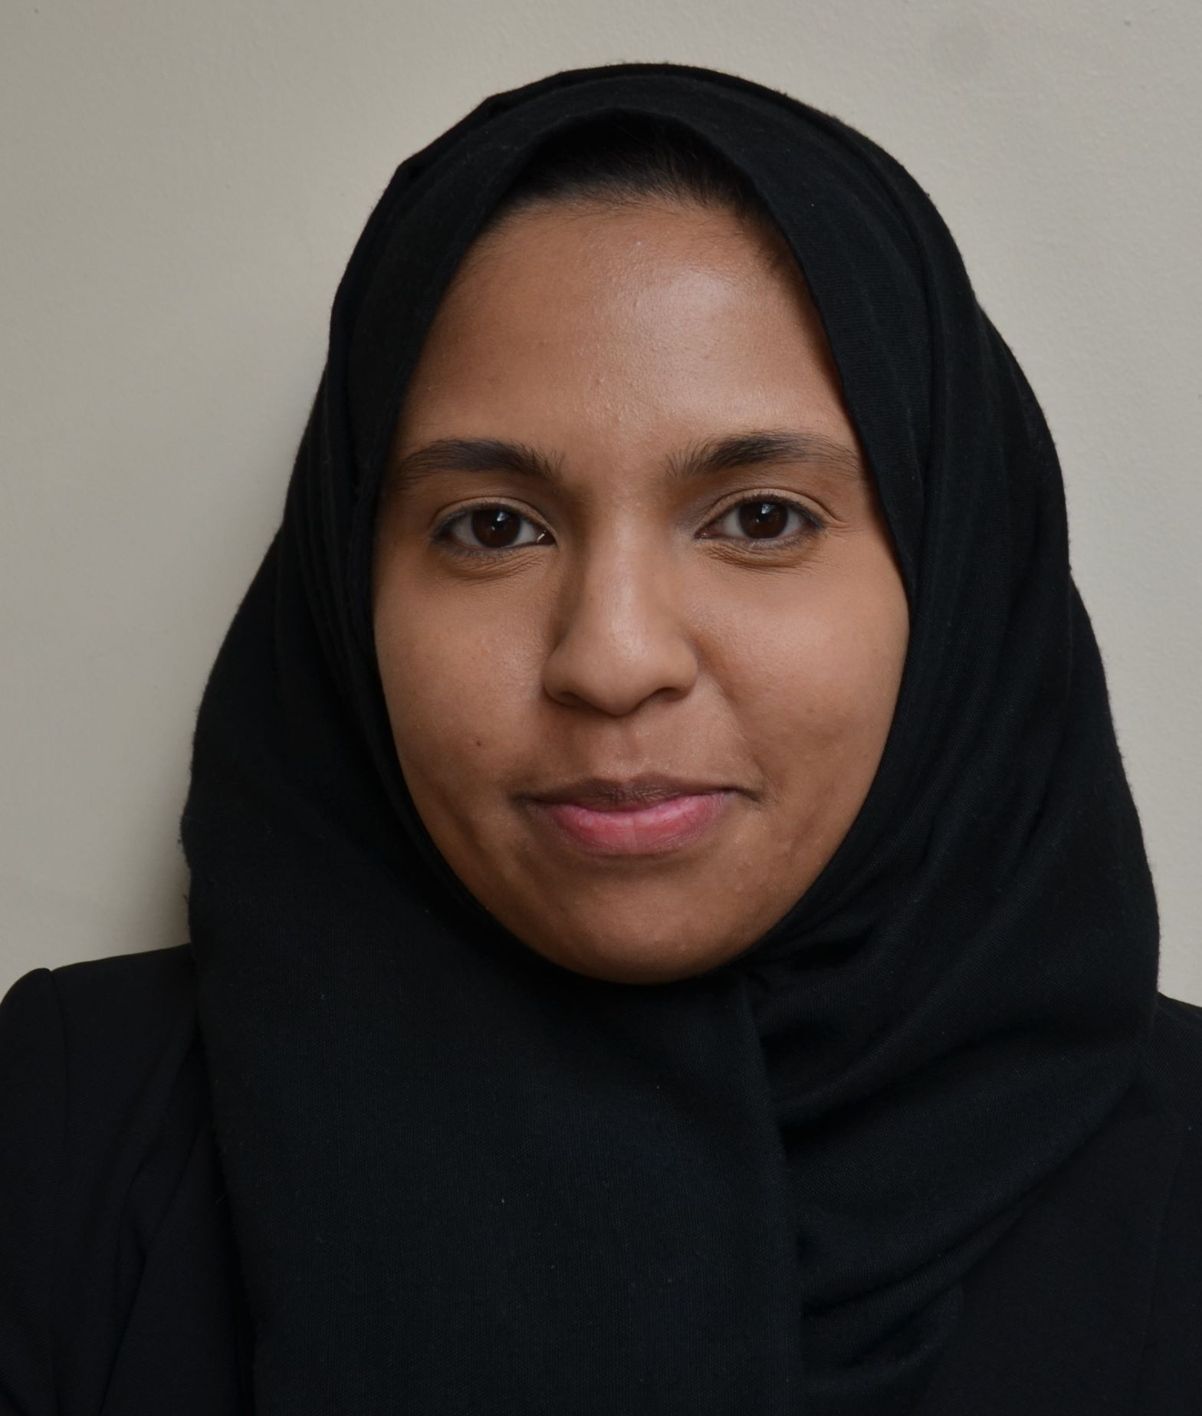
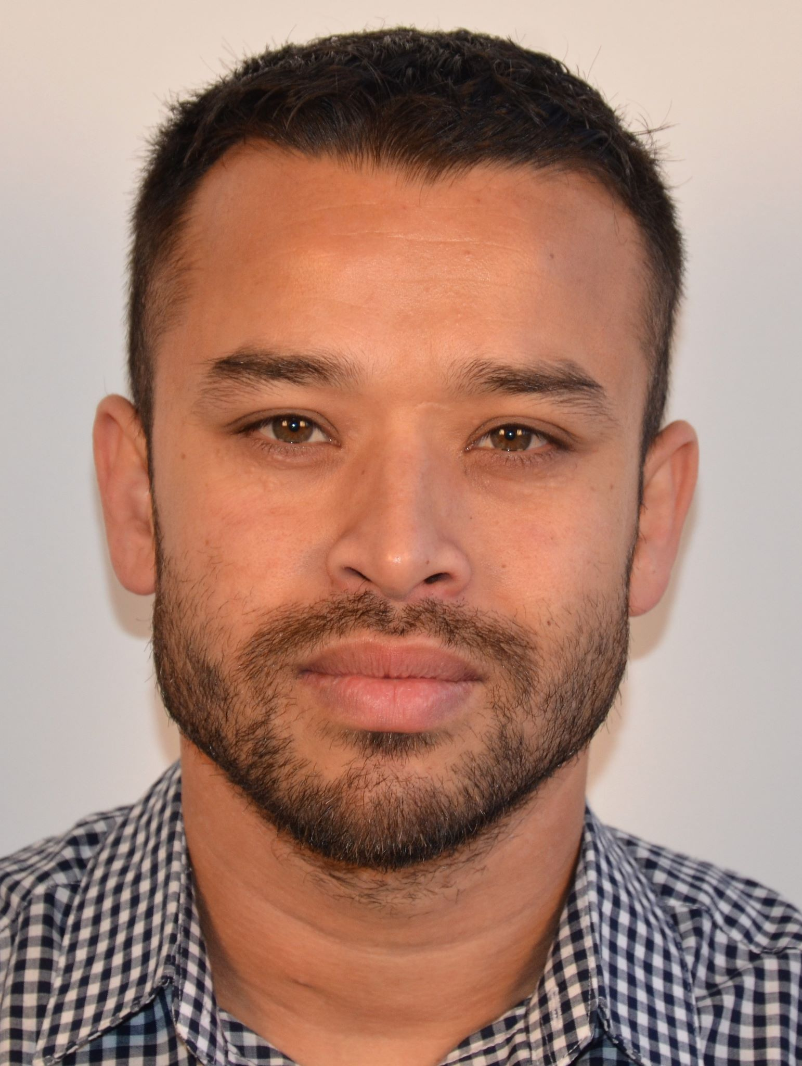
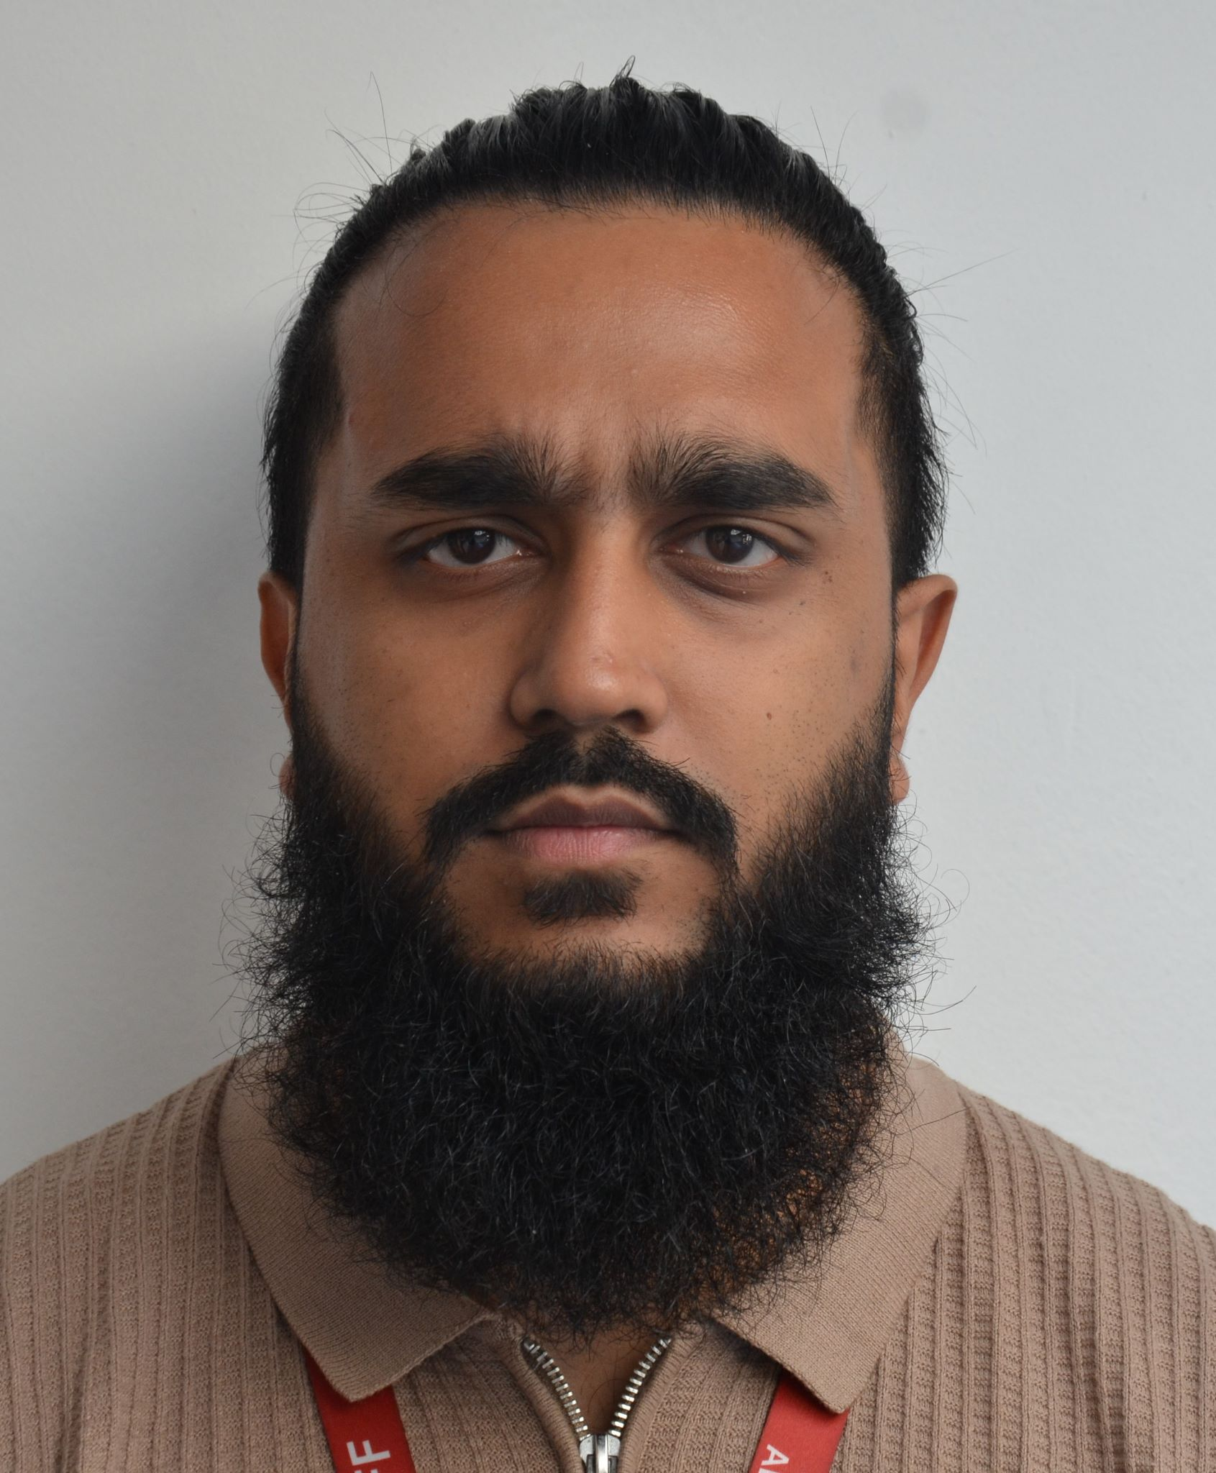
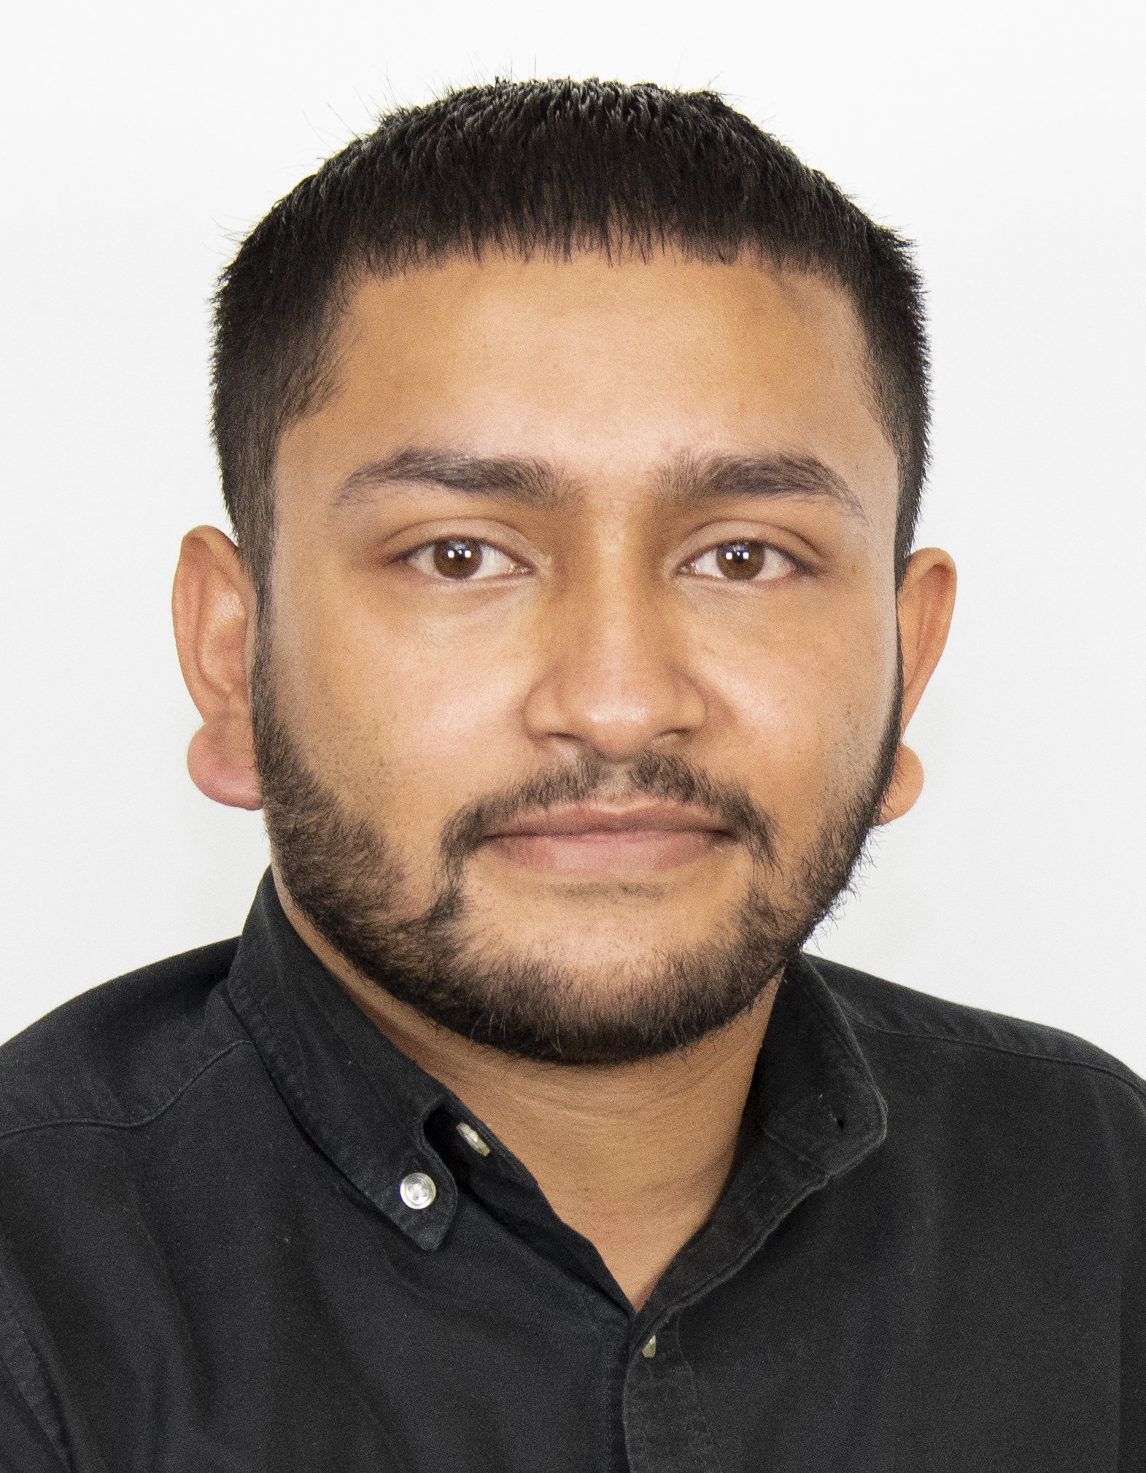
Sixth Form Team
Mr P Woods
Headteacher
Mr B Siaw
Deputy Headteacher
Mr A Hoque
Assistant Headteacher
Ms R Yasmin
Head of Year 12
Mr I Iqbal
Head of Year 13
Mr C Rothon
Behaviour & Safeguarding
Mr T Hussain
Attendance Officer
Ms S Begum
UCAS Coordinator
Mr F Uddin
Careers Manager
Mr T Islam
Study Supervisor
Mr K Hoque
Admin Assistant

Slide 3
Stepney All Saints School expects of students:
To wear identity passes at all times while on school premises and understand that entrance will be refused without it. Lost or damaged passes will need to be replaced and will incur a cost
To tap in/out when entering/ leaving the Sixth Form Premises, in the interests of safety and security
To aim for 100% attendance and punctuality to all lessons, registration and assemblies, and to ensure that their parent or guardian contacts the school’s attendance officer to inform them of the reason for absences. Failure to do this will effect a student’s eligibility for the 16-19 Bursary and could lead to Formal Warnings and loss of their place in the 6th Form
To work to the best of their ability, completing all work set by teachers and meeting all deadlines
To respect all members of the school community
To take responsibility for their own work and behaviour
To adhere to modern British values of democracy, the rule of law, individual liberty, and mutual respect and tolerance of those with different faiths and beliefs.
To adhere to the dress code, follow the code of conduct and online acceptable user policy (AUP); to be mindful of the reputation of the school at all times. This includes behaviour outside of and in the near vicinity of the school and not to use mobile devices and equipment on school premises
Never to use the school’s name/ logo without prior consent or authorisation
To care for all school equipment, the buildings and respect the school environment
To never bring items into school which are unsafe, for example, weapons or any illegal substances, and to understand that students who do this will lose their place at school.
Post-16 Home School Agreement
Stepney All Saints School will aim to provide:
A safe and secure learning environment for all
The highest standards of care and discipline to promote respect for all
A learning environment, including equipment, resources and facilities to promote confidence and independence in our student as learners
Academic guidance and assistance to pupils throughout their school career; regular reports, information and consultations about progress
A dedicated Form Tutor and regular assemblies with opportunities for collective worship and reflection time
A comprehensive induction and PSHE programme enabling personal and social development
Financial support to those who need it and access to numerous university scholarship opportunities
A CIEAG (Careers Information, Education, Advice and Guidance) programme designed to prepare students for life in modern Britain by providing the knowledge, understanding, confidence and skills that they need to make informed choices and plans for their future learning and career

Slide 4
Parents and/or Guardians:
To support the school and the ethos and values
To work in partnership with the staff
To inform the school promptly of any concerns
To respond to concerns raised by members of staff
To ensure regular and punctual attendance of their child/children to school.
To understand that taking your child/ children on holiday during term time will not be authorised by the school and may affect your child’s ability to progress to university and further education.
To support the high standards of discipline, behaviour and security in the school
To acknowledge the part that good discipline, behaviour and security play in high attainment
To support the school in upholding modern British values
To attend all Parents’ Evenings and Academic Review Days
To give consent to the school to use images of their child for publicity and promotion
Important:
Students will have their pathway reviewed at the end of Year 12. Hard and soft data will be used to decide which pathway students pursue in Year 13.
This includes: mock exam grades, intervention programmes and re-assessments, tracking and class data, behaviour and reward points, engagement in the SASS Futures Programme, SASS Champions Programme and The Personal Development Programme.

Slide 5
Sixth Form Formal Warning System
How do students trigger a Formal Warning?
1.) Students will be issued a Formal Warning for repeated Level 1 and Level 2 behaviours (50 behaviour points increments trigger a formal warning)
2.) Students will be issued a Formal Warning for not meeting course requirements due to attendance and punctuality
3.) Students will be issued a Formal warning for Level 3, 4 or 5 behaviours
PLEASE ADD IN BEHAVIOUR FLOW CHART …page 36 from behavior policy

Slide 6
Sixth Form Formal Warning System
 | Staff | Compulsory Actions | Possible Actions
First Formal Warning | KS5 PS/HoY | Formal warning letter to warn Parent/Carer/Student that they are in danger permanent exclusion. | Fixed term suspension (5 days minimum) Placement in SLC Progress/attendance report PAP Detentions (loss of break and lunch time privileges) Referral to agencies Counselling/mentoring referral
Second Formal Warning | KS5 PS/HoY/AST | Formal warning letter to warn Parent/Carer/Student that they are in danger of permanent exclusion. | Fixed term suspension (10 days minimum) Placement in SLC Progress/attendance report PAP Detentions (loss of break and lunch time privileges) Referral to agencies Counselling/mentoring referral Support from Careers Manager
Third Formal Warning | AST/DH | Head Teacher’s Letter | Fixed term suspension (15 days minimum) Placement in SLC Progress/attendance report PAP Detentions (loss of break and lunch time privileges) Referral to agencies Counselling/mentoring referral Support from Careers Manager
Fourth Formal Warning | Head Teacher | Head Teacher’s Letter | Permanent Exclusion Referral to Youth Workpath Support from Careers Manager
How do students trigger a Formal Warning?
1.) Students will be issued a Formal Warning for repeated Level 1 and Level 2 behaviours (50 behaviour points increments trigger a formal warning)
2.) Students will be issued a Formal Warning for not meeting course requirements due to attendance and punctuality
3.) Students will be issued a Formal warning for Level 3, 4 or 5 behaviours

Slide 7
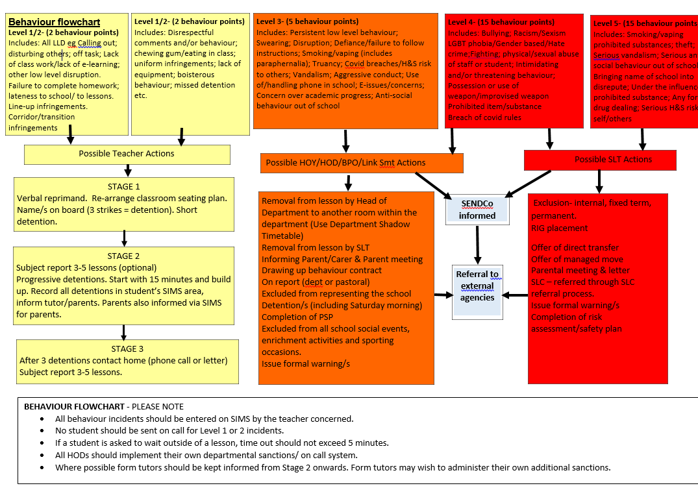

Slide 9
Dress Code
If you do NOT meet the dress code requirements, you maybe asked to go home and change.
Items that are not allowed:
Hats/baseball caps
T-shirts and polo shirts, vest tops or crop tops, t shirt style tops
Jeans, leggings, jeggings or tracksuit bottoms (even if the jeans are black)
Denim jackets
Hoodies or sweatshirts or long cardigans
Shoes should not have a stiletto heel, be trainers or canvas pumps, flip-flops, sandals and informal boots are not permitted
Black trainers
Mandarin collar style shirts that do not allow for a tie
Large logos are not permitted
Jackets and coats must not be worn inside the school buildings (not beyond reception point)

Slide 10
Attendance & Punctuality
At Stepney All Saints School we have a clear expectation that students should aim for 100% attendance every year. We view attendance above 98% as excellent. Attendance below 96% is concerning and your parents may be contacted, should attendance fall to 90% or below, parents will be contacted, you may be put on reports, formal warnings will be given and you risk losing your school place at SASS
Students are expected to attend every single lesson ON TIME, including form time, assemblies, PSHE and any extra enrichment classes.
Only stay off school if you are seriously ill; if you feel unwell in the morning, you must still try to come in late rather than take the whole day off. Stomach aches, headaches, “Not well” and other minor illnesses will not be authorised absence.
On the day of absence your parents/carers must call the school and inform us of the reason for absence. Failure to do so will lead to unauthorised absence.
Medical appointments must be made outside of school hours, I.e. after school or during the school holiday
You MUST show evidence to Mr Hussain/ HOY / Mr Rothon for any time taken off due to medical appointments i.e. note from Dr, reminder emails, hospital letters etc.
Authorised Vs unauthorised absence – when absence is authorised by school, it means school acknowledges a legitimate reason for your absence however this will still affect your overall attendance. If attendance remains unauthorised you have NO grounds to appeal for bursary, this is also reflected on your attendance grid and is seen by universities, potential employers.
Absences for university open days, interviews, work experience, trips you must see Mr Hussain prior to attending with evidence (this will be authorised and will NOT affect your attendance)
Holidays during term time: Will be unauthorised in most cases and you run the risk of losing your school place at SASS
Mr Hussain (Attendance Officer) Tel: 0207 790 6712 Ext. 161 Email: sixthform@stepneyallsaints.school

Slide 11
.
BURSARY
​All students (Year 12 & 13) must apply at the start of the academic year to be entered for bursary. (You will not be able to apply for bursary mid year if you miss the deadline)
Online Bursary Application will open on the 1st of October 2022 and close on the 31st of October 2022.
Bursary application link will be sent via text message to all students. Please ensure that we have your most up to date phone number on the system, otherwise you will not receive the link.
If you fail to submit your application form before the deadline, you will not be entered for the bursary for that academic year.
You must have an Attendance and Punctuality of 97% and above including all subject lessons, assemblies, PSHE and Form Class to receive bursary payment.
If you believe there is any errors while registers were taken this MUST be addressed via the Attendance Officer ASAP and not upon rejection.
You must keep on top of your attendance tracking every week via your form tutor to ensure all your attendance marks are accurate. Students will be granted 2 weeks grace period to rectify any attendance issues.

Slide 12
BURSARY
In order to qualify for bursary you need to meet both Section A and B criteria's below:
16-19 Bursary Requirements:
Section A: General Criteria
Student need to be enrolled on a full time course, maintaining 100% attendance and punctuality throughout lessons, assemblies, PSHE, form clas and enrichment. Additionally, target grades in all subject areas should be achieved, ensuring that outstanding progress is consistently being made across the board.
Section B: Specific Criteria – Must fall into one of the three categories below
-Guaranteed Bursary - If a student is in care; a care leaver; is personally in receipt of income support or a disabled young person in receipt of Employment Support Allowance and Disability Living Allowance, providing they are enrolled on a full time approved course. Evidence of eligibility is required through an official letter.
-Students who are entitled to Free School Meals - Students who have successfully claimed Free School Meals for the current academic year. The evidence for this would be a Local Authority Letter confirming eligibility for free school meals.
-Shared Residual Allocation - Students whose household is in receipt of Income Support, Pension Guaranteed Credit or an official letter confirming receipt of Income Support.
Bank statement and screenshot are NOT accepted as proof of entitlement!

Slide 13
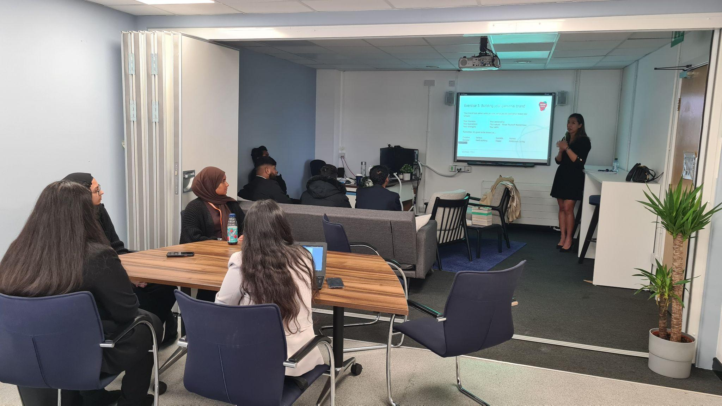
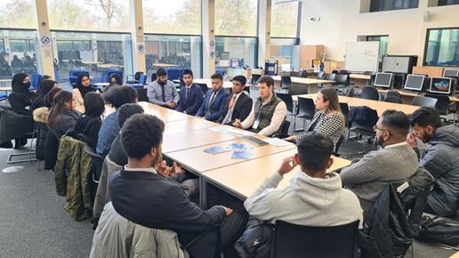
What careers support do we provide?
Here at Stepney All Saints Sixth Form, our aim is to expose our students to a variety of experiences so they are more informed about future prospects and pathways. There is a key focus on long term mentoring and workplace visits throughout the year. It is expected that students take on at least one of these opportunities.
Some of our key offers include:
- Head to Head Plus (Virtual Mock Interviews)
- Aim2Attain – Mentoring with Barclays
- Bayes University Mentoring
- Career Ready Mentoring and Work Placements
- Duke of Edinburgh Award
- EY summer opportunities
- Volunteering Opportunities
- NCS Autumn and Summer Camps

Slide 14
WHAT IS THE SASS CHAMPIONS PATHWAYS PROGRAMME?
All students are expected to take part in this programme. It is an enrichment programme designed prepare students to apply successfully to Russell group universities and high quality apprenticeships. It allows the students the following:
An opportunity to learn new skills and increase their cultural capital
To find out more about a chosen career path
To write a rich and engaging personal statement outlining the skills and interesting experiences that they have gained through the Champions pathway (500 words min)
This can be used to support UCAS/apprenticeship application or even a job application.

Slide 15
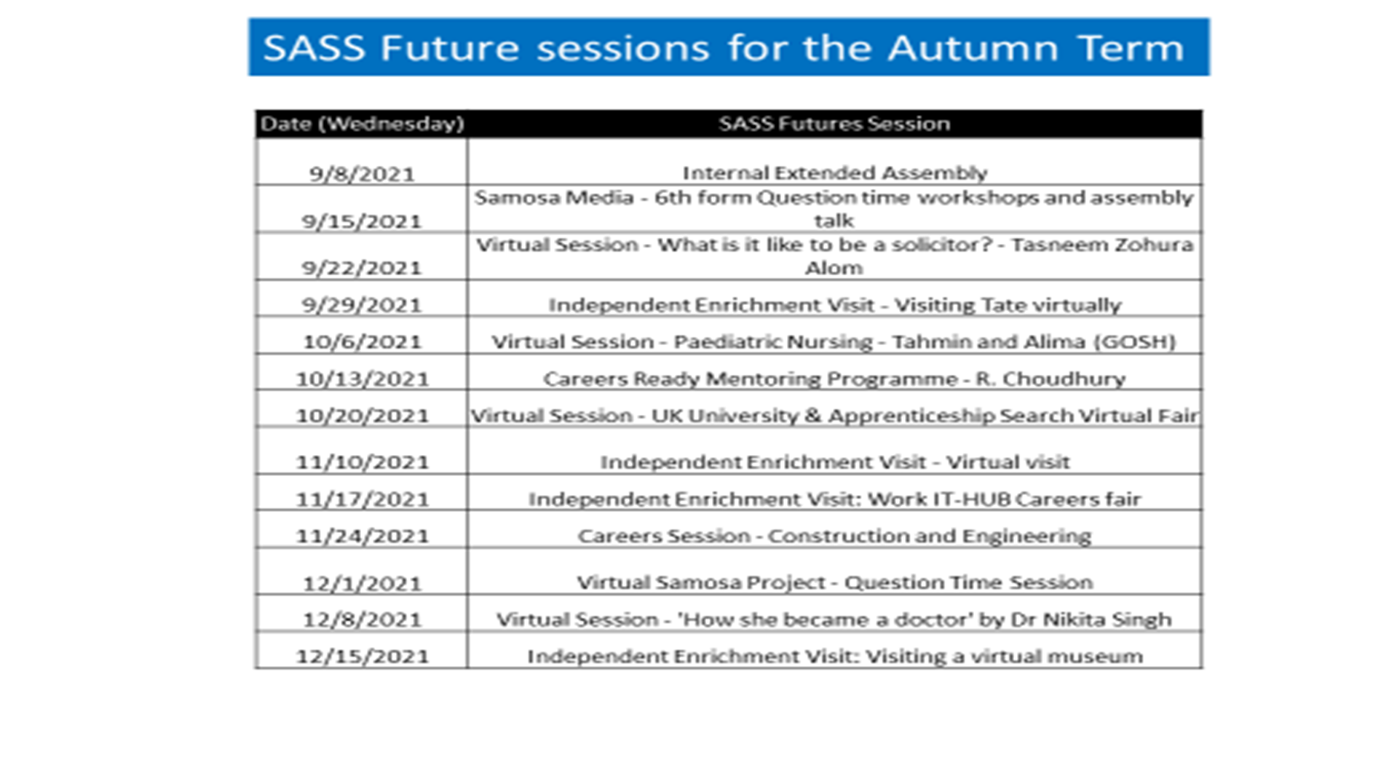
SASS FUTURES PROGRAMME
SASS Futures is an enrichment programme specifically developed for the entire Yr12 cohort.
It is an expectation that all students COMPLETE these sessions virtually.
It incorporates a range of activities:
Lectures from external speakers which include university tutors, former students, inspiring leaders. The lectures will comprise of a mixture live and virtual sessions.
Sessions on Careers led by Mr Uddin who has developed a specific programme for SASS Futures which will cover the essential themes such as CV, degree apprentice vs standard degrees, experience opportunities.
Independent enrichment visit to museums and other places of interest (physically/virtually) in order to develop your culture awareness and well being further.
Example for 2021-22

Slide 16
Personal Development Programme
All students will receive a PDP booklet that will be used to log activities, reflect on experiences and gather evidence.
There will be prizes for students who manage to successfully complete the programme demonstrating a level of excellence.
This will be monitored by tutors and all students are expected to complete the booklet.

Slide 17
Personal Development Programme (PDP)
Key aim: Develop leadership, commitment and life skills through enrichment and extra-curricular activities (The Personal Development Programme)
Four Key Skills:
Four Activity Strands:
Key skills to be developed over the course of the academic year and applied in each activity strand
COMMUNICATION
LEADERSHIP
COMMUNITY
WELLBEING
TEAMWORK
PROBLEM SOLVING
SCHOOL
ENRICHMENT

Slide 18
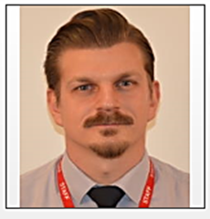
Safeguarding
If you, or someone you know does not feel safe, you can talk to Mr Cameron, Mr Rothon, Ms Motin, your Head of Year, or any member of staff in school that you trust.
Mr Cameron
iain.cameron@stepneyallsaints.school
Mr Rothon
christopher.rothon@stepneyallsaints.school
Ms Motin
parul.motin@stepneyallsaints.school

