Slide 1
A Level Media Taster Lesson
What is the effect of ownership on media Industries?
L.O.s
Recall prior knowledge
Compare and contrast newspaper ideologies and contexts
Make a judgement on the effect of ownership on newspapers
A Level Media basics:
Year 12: | Component 1 & NEA | Media Products, Industries and Audiences | Written examination – 2 hours 15 minutes. 35% of qualification. 90 marks NEA – 60 marks. 30 %
Year 13: | Component 2 | Media Forms and Products in Depth | Written examination: 2 hours 30 minutes 35% of qualification 90 marks
*10 Hours split over 2 weeks *Exam board = Eduqas

Slide 2
PERSON B
DISCUSSION POINT
PERSON A
In pairs or small groups recall prior knowledge and discuss your answers to the following:
What brands of newspapers do you know?
What is the purpose of a newspaper?
Why are there so many different newspapers in the UK?
Are all newspapers neutral in their reporting of the news?
https://youtu.be/DGscoaUWW2M

Slide 3
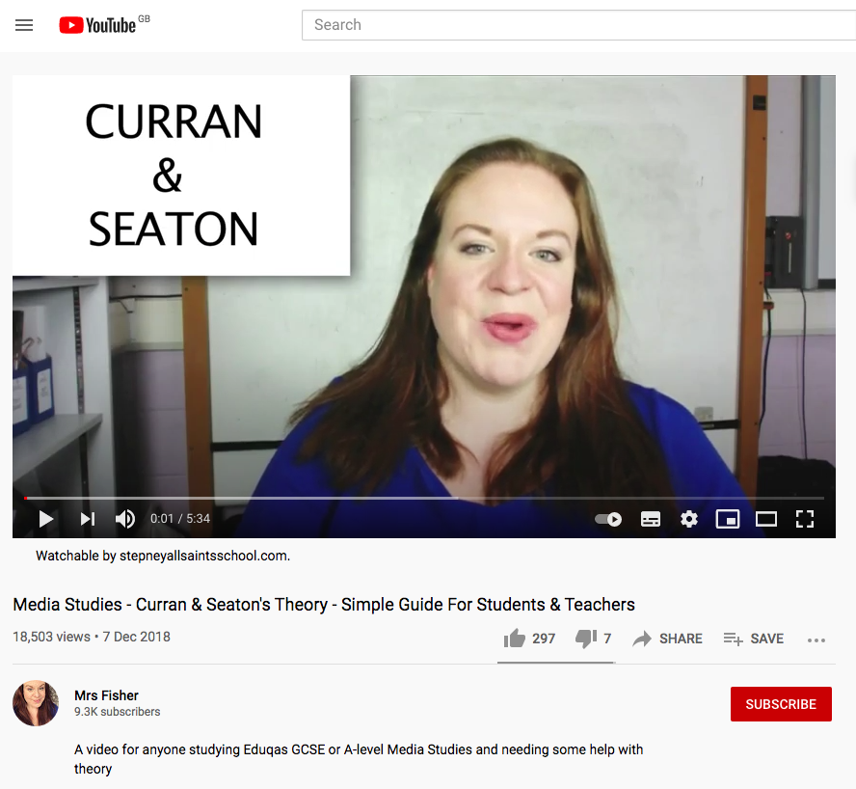
*PRE-LEARNING TASK:
https://youtu.be/KUteUbVS5DA
Mrs Fisher: Media Studies - Curran & Seaton's Theory - Simple Guide
*This is usually set prior to your lesson on Google Classroom
Directions: Watch the video and take notes on what Curran and Seaton’s main ideas are and examples that support this
Idea | Explanation & examples

Slide 4
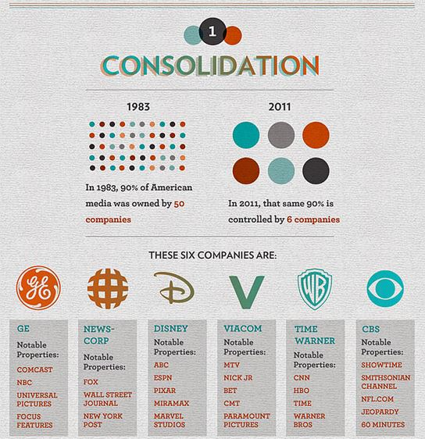
Curran and Seaton
The idea that the media is controlled by a small number of companies primarily driven by the logic of profit and power
The idea that media concentration generally limits or inhibits variety, creativity and quality - This means that these companies tend to make ‘safe’ products (in terms of content) that will guarantee them profit.
This dynamic of power means that media companies have lots of power over the way the public think but no responsibility to provide fair and accurate content.
The idea that more socially diverse patterns of ownership help to create the conditions for more varied and adventurous media productions. This means that media products made by more independent (small) companies tend be more creative or ‘different’ to those produced by mainstream companies.
Add to your notes!
Notes:
Just three companies—DMG Media, News UK and Reach—dominate 90% of the national
newspaper market, up from 83% in 2019. When online readers are included the same
companies control a four-fifths market share amongst the major newspaper groups, giving these
publishers a strong position for setting the agenda for the rest of the news media.
83% of UK local newspapers are controlled by just six companies. The three largest local
publishers—Newsquest, Reach and JPI Media—each control a fifth of local press market, more
than the share of the smallest 50 local publishers combined.
Facebook controls three of the top five social media services used to access online news in the
UK. Traditional news organisations account for 48% of Facebook users’ news sources,
expanding the online market reach of a few already-dominant publishing companies.
While Sky remains the UK’s dominant pay-TV provider with 8.3 million customers, across all
households with at least one SVOD subscription 87% are Netflix customers (14.2 million) and
more than half subscribe to Amazon Prime Video (9.1 million).
Two companies—Bauer Radio and Global Radio—own 70% of the UK’s 279 local commercial
analogue radio stations—a 20% increase in concentration since 2018. Similarly, three-quarters
of the national commercial DAB market is controlled by Bauer, Global and Wireless Radio.

Slide 5
APPLICATION OF KNOWLEDGE:
Task: Case Studies
The Mirror (REACH)
Group 1
The Times (NEWS CORP)
Group 2
 | Evidence from Factsheet | Does this fit with Curran and Seaton’s ideas? If so, which ones?
What other newspapers do they own?
What other companies do they own?
What profits do they make?
What percentage of the newspaper market do they occupy?
Has there been an increase or decrease in the variety and diversity of news?

Slide 6
EVALUATION OF THEORY:
Directions: Put an ‘X’ on the scale and be prepared to justify your reasoning. Then after our class discussion write paragraph, using examples you have looked at, to consolidate your position.
How far do you agree that the media is controlled by a small number of companies primarily driven by the logic of profit and power?
Completely disagree
Completely agree

Slide 7
Media - the key to your career…

Slide 8
EXTEND YOUR KNOWLEDGE
The Media Department recommends:
Media Theory for A Level provides a comprehensive introduction to the 19 academic theories required for A Level Media study.
From Roland Barthes to Clay Shirky, from structuralism to civilisationism, this revision book explains the core academic concepts students need to master to succeed in their exams.

Slide 9
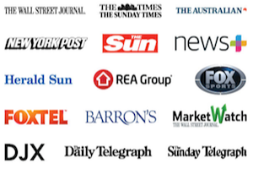
With 9 leading national newspapers and more than 110 regional titles and over 70 online brands, Reach has the largest audience across the UK of any commercial national and regional news publisher, and a leading presence in Ireland. We create engaging and differentiated content which is distributed through our newspapers, magazines and digital platforms. Our newsbrands have a long heritage of being trusted sources of news and information – nationally and locally.
Some 48 million people a month in the UK use Reach for news, entertainment and sport.
The newspapers are printed by Reach Printing Services Ltd. Also in the family of companies are Reach Solution, a marketing strategy company. Reach owns several gambling brands: Mirror Bingo, Express Wins and Star Wins. It’s Digital Recruitment arm operates three specialist job boards: GAAPweb, TotallyLegal and SecsintheCity.
Reach, PLC's headquarters is in London, England. Reach, PLC has a revenue of $918.6M, and 4,772 employees. Reach, PLC's main competitors are Newsquest Media Group, Ltd., News UK and Future.
News Corp is a media and information services company. The Company has businesses across a range of media, including news and information services, subscription video services in Australia, book publishing and digital real estate services. Its segments include News and Information Services, Subscription Video Services, Book Publishing and Digital Real Estate Services. The News and Information Services segment includes its global print, digital and broadcast radio media platforms. Subscription Video Services segment provides video sports, entertainment and news services to pay-tv subscribers and other commercial licensees. Book Publishing segment consists of HarperCollins, a consumer book publisher with operations in approximately 17 countries and particular strengths in general fiction, nonfiction, children’s and religious publishing. Digital Real Estate Services segment consists of REA Group and Move.
The Company reported 2020 total revenues of $9.01 billion

Slide 10
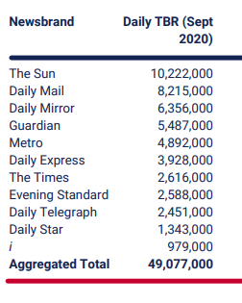
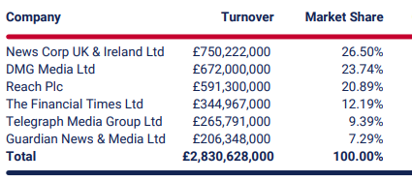
Declining local newspaper coverage
Research by Plum Consulting has highlighted the deepening crisis in the geographic coverage provided by local newspapers in the UK. In 2019 65% of the 406 Local Authority Districts (LADs) in the UK were not covered by a single daily local. More than half of local areas in the UK (54.9%) were served by only one publisher, representing an increase of almost 10% in the number of local newspaper monopolies since
2017.
The prevalence of news ‘deserts’ in the UK is accompanied by continuing job cuts, redundancies and consolidated newsrooms across the local and regional press industry. Currently available data makes it increasingly difficult to account for the number of print newspapers which have moved to an online-only format or been merged into wider regional news ‘hubs’.
However, reporting by Press Gazette indicates that at least 785 jobs at local newspapers have been cut since January 2019, while between 2,000 and 5,000 jobs are at risk due to cuts and print suspensions brought about by the Coronavirus pandemic.
Total Brand Daily Reach
Notes:
https://www.mediareform.org.uk/wp-content/uploads/2021/03/Who-Owns-the-UK-Media_final2.pdf

