Slide 1
A Level English Literature
Learning Objective:
I can discuss a text at length by applying a range of critical approaches to it.
What do you think about our text?
Where the Wild Things Are
Everybody has to make at least one point about it!
https://www.youtube.com/watch?v=3FsBaRYRPnU

Slide 2
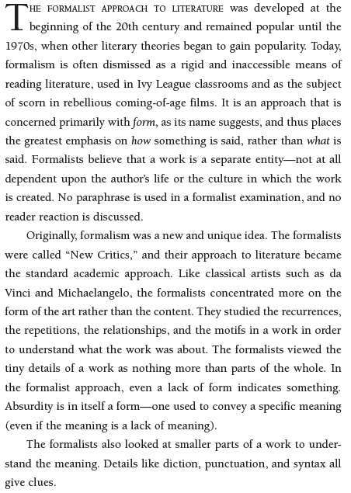
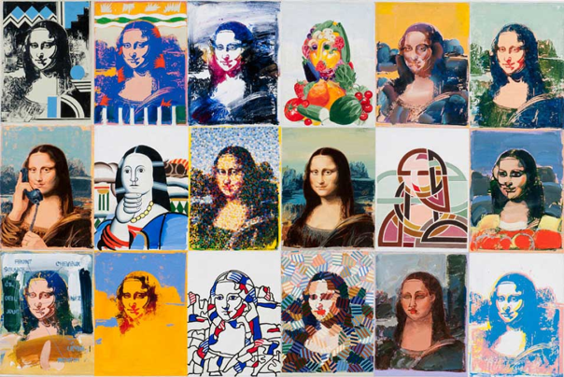
A formalist approach
The ‘Ivy League’ are the most prestigious universities in the USA. Here, the writer is suggesting they are not in touch with the real world.
Motifs = repeated symbols or patterns

Slide 3
A formalist approach
Does the text have recognizable features of a particular genre?
How is the action sequenced? Chronologically? Via flashbacks? Cyclically?
What is the point of view of the narrator? What perspective do they have of the protagonist? What do they miss out?
How do repeated patterns of sound or rhythm affect the text?
What patterns are there in the lengths of text in different sections? (For WTWTA, look at the balance of text and image on each page.)
Are there examples of foreshadowing?
How does the setting add to the meaning?
What would a diagram of the plot look like?

Slide 4
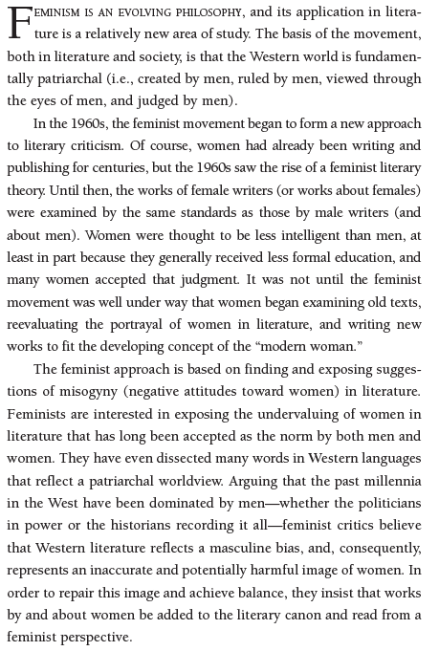
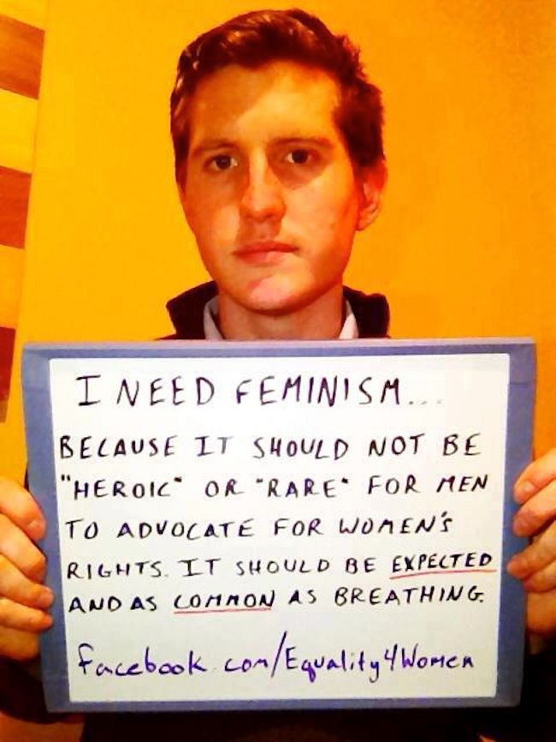
A feminist approach
Examples: we talk about a ‘master key’ or ‘mastering a skill’; we refer to the achievements of ‘mankind’
The ‘literary canon’ means the group of texts which are regarded as ‘classic’ and the most important texts to know.

Slide 5
A feminist approach
How many characters of each gender are there? How large/significant are their roles?
What gender stereotypes are presented? Are any subverted?
Are female characters: oversimplified; weak; foolish; naïve; temptresses; excessively fixated on rules?
Are female characters primarily viewed through their relationships with male characters rather than as independent entities?
How do male characters talk about female characters and vice versa?
Are any of the dominant images associated strongly with a particular gender?
How do the major themes of the text relate to issues associated with gender?
Is the text written by a man or a woman?

Slide 6
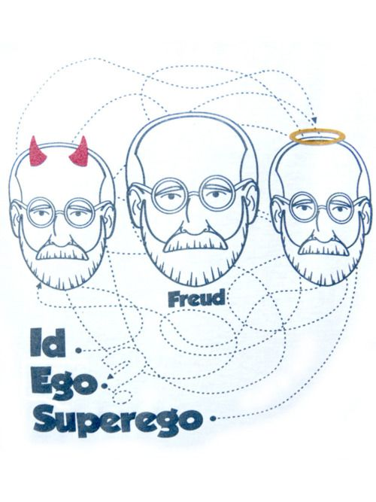
A psychoanalytic approach
Psychoanalytic literary criticism is a way of analysing and interpreting literary works that relies on psychoanalytic theory. Psychoanalytic theory was developed by Sigmund Freud to explain the workings of the human mind. In this field of literary criticism, the major concepts of psychoanalytic theory, such as the idea of an unconscious and conscious mind, the divisions of the id, ego, and superego, and the Oedipus complex, are applied to literature to gain a deeper understanding of that work.
The idea of a conscious and an unconscious mind is one of the most important tools in psychoanalytic literary criticism. Freud theorized that people have a conscious part of the mind, where thinking takes place and where they are aware of their thoughts. He also proposed the idea of an unconscious part of the mind, where desires and drives exist that people are not aware of, but that affect them and sometimes cause psychological problems.
Freud would often analyse dreams, which he believed were windows into the working of the unconscious mind. He believed dreams had obvious, or manifest, content that masked the latent, or unconscious, desires and drives. He used symbolism and dream analysis to discover the latent content of the dream.
One technique in psychoanalytic literary criticism is to treat a work of literature as though it is a dream. The goal of this technique is to understand the unconscious symbols and desires through interpretation of the more obvious content. This type of literary criticism uses symbolism and other forms of analysis to get at the latent content of a work of literature.
Childhood experiences are extremely influential and, to a large degree, shape a person’s psyche, according to Freud. In his theory of the Oedipus complex, a child begins life by being very attached to the mother figure. The child begins to be jealous of the attention the mother gives to the father, which leads to repressed anger toward the father and a desire to possess the mother. Psychoanalytic literary criticism may use this theory of development as a way to understand the repressed content of literature.
Freud believed the experiences of childhood lead to the development of three divisions in the mind: the ego, the id, and the superego. The ego is the conscious part of the brain, the part a person is aware of. The id is the unconscious or repressed desires a person has, including the desires caused by the Oedipus complex. The superego is the conscience, the judge and jury in a person’s mind. Psychoanalytic literary criticism looks for the influences of all three parts of the mind in literature.

Slide 7
A psychoanalytic approach
What are the main character traits of the protagonist?
Are there any discrepancies between how the protagonist views her or himself and how others view her or him?
Does the protagonist change their understanding of themselves over the course of the story?
How do the characters view one another?
Are there any Oedipal elements to parent and child relationships within the text?
Can any of the images used be viewed as symbolic of particular desires or fears experienced by the protagonist?
Are there any dream sections or extended inner monologues? What do they reveal?
Are there any internal conflicts within a character? Are they resolved? How?

Slide 8
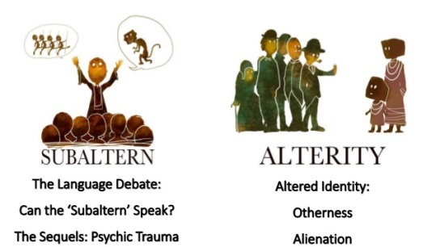
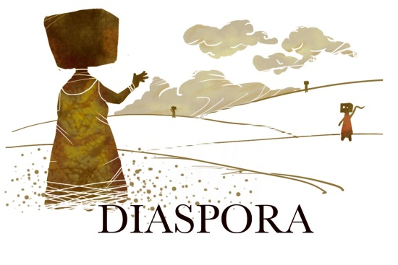
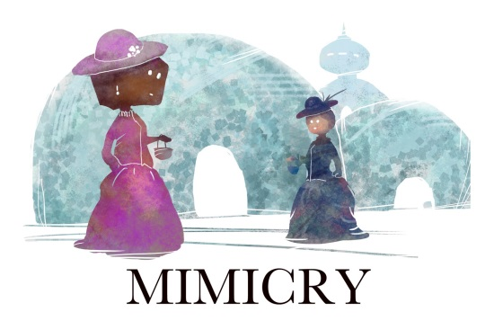
A post-colonialist approach
Post-colonialism (also known as post-colonial theory) refers to a set of theories in philosophy and literature that grapple with the legacy of colonial rule. As a literary theory or critical approach it deals with literature produced in countries that were once, or are now, colonies of other countries. It may also deal with literature written in or by citizens of colonizing countries that takes colonies or their peoples as its subject matter. Postcolonial theory became part of the critical toolbox in the 1970s, and many practitioners take Edward Said's book Orientalism to be the theory's founding work.
Post-colonialism deals with many issues for societies that have undergone colonialism: the dilemmas of developing a national identity in the wake of colonial rule; the ways in which writers from colonized countries attempt to articulate and even celebrate their cultural identities and reclaim them from the colonizers; the ways knowledge of colonized people have served the interests of colonizers, and how knowledge of subordinate people is produced and used; and the ways in which the literature of the colonial powers is used to justify colonialism through the perpetuation of images of the colonized as inferior. The creation of binary oppositions structure the way we view others. In the case of colonialism, distinctions were made between the oriental and the westerner (one being emotional, the other rational). This opposition was used to justify a destiny to rule on behalf of the colonizer, or 'white man's burden'.
Colonized peoples responded to the colonial legacy by writing back to the centre. This came about as indigenous peoples became educated, and began to write their own histories, their own legacy. They used the colonizers’ language (mainly English) for their own purposes.
Attempts at coming up with a single definition of postcolonial theory have proved controversial, and some writers have strongly critiqued the concept, which is embedded in identity politics.
As suggested by its name, post-colonialism is about dealing with the legacy of colonialism. Perhaps somewhat surprisingly the most prominent form this has taken to date has been in the cultural realm, especially with respect to identity politics and literary studies. Thus, the most common way the term has been used is in reference to a genre of writing and cultural politics, usually by the authors from the countries which were previously colonised. All post-colonialist theorists admit that colonialism continues to affect the former colonies after political independence.

Slide 9
A post-colonialist approach
What power-structures exist between characters of different backgrounds?
How are these power-structures established, maintained, or undermined?
Are any national or racial groups presented as being ‘normal’ or ‘other’?
Are any national or racial groups presented as being more emotional or rational than others?
Is the text written in a ‘native’ language or one inherited from colonizing powers?
How do details of language add to ideas of cultural dominance?
Does the story suggest movement away from a colonial past or continued restriction arising from it?

