Slide 2
Learn your route to school
Find out who you can speak to in school if you’re finding it difficult
Write the names of your teachers on your timetable
Take your time getting to know people
Ask teachers for help if you are finding the work difficult
Keep a school map in your pocket
Learn the school rules
Make a homework timetable
Ask someone you trust to do the journey to school with you before doing it alone
Talk to an adult at home about your worries
Make a photo album of all your friends at primary school
Remember what you are good at
Find out when and where school clubs run
Think positively (I can do this!)
Notes:
If this text size is too small for your class, we recommend printing out the viewpoints and strategies as a handout.

Slide 4
HANDY ADVICE!: HANDS
What actions can pupils take to manage the changes in secondary school?
Notes:
Ask pupils to go back to their sheets with the stick person and add information to the hands of the body about what ACTIONS or STRATEGIES pupils could take to manage change – moving to secondary school.
Pairs/small groups move around the classroom and find a different group’s body sheet, discuss their comments and the questions below, adding any additional information to the sheet they see fit.

Slide 5
I can identify the differences between primary and secondary school.
I can describe how it might feel to move to secondary school.
I can explain some ways to manage this change.
0
10
NOT CONFIDENT
EXTREMELY CONFIDENT
Notes:
Pupils should answer the three baseline questions on a confidence scale: 0 = not confident, 10 = extremely confident.
Ask pupils to consider why their scores have changed and give an example of something new they have learned or thought about.

Slide 6
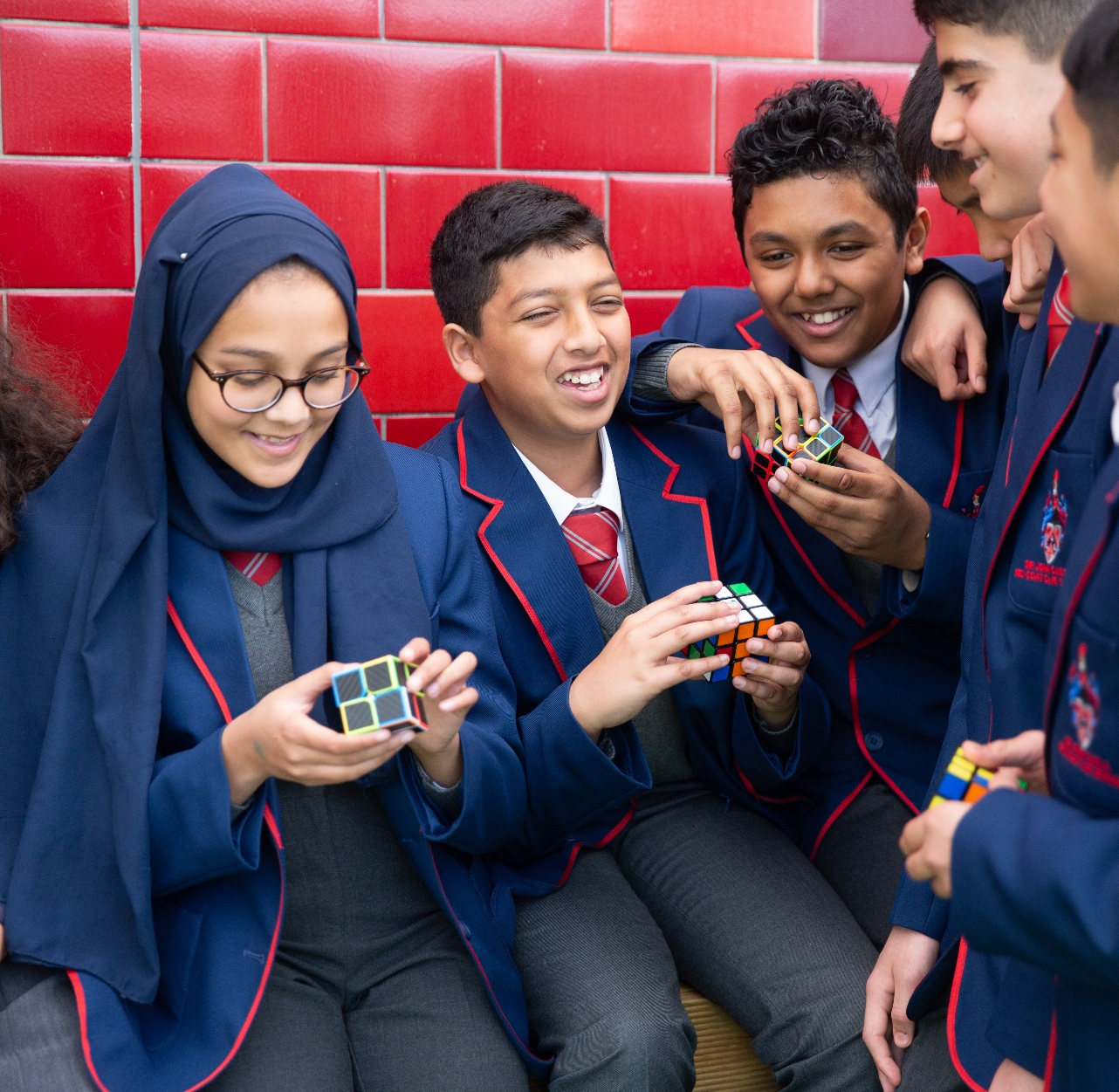
What could a pupil pack on their first day of secondary school to help them manage the change ahead?

Slide 7
It is normal to have lots of different feelings when change occurs.
If you are worried about changes affecting you or a friend, remember you can always speak to an adult at home or your teacher, or you can visit ChildLine.
Notes:
Before the end of class, remind pupils about the importance of asking for help if they need it and signpost them to speak to a trusted adult or call ChildLine.

Slide 9
For more great advice, visit BBC Bitesize – Moving to Secondary School

Slide 10
Go to www.stepneyallsaints.school for details

